Slide 1

Open Enrollment 2025
Plan Year beginning August 1, 2025
Enroll June 30 – July 11

Slide 2
What is Open Enrollment?
Once enrolled, you will not be able to make changes or cancel coverage until the next Annual Open Enrollment period!
Qualified Life events
  Marriage
  Birth, adoption
  Change in job status
  Change in Medicare status
Make changes to benefits
Add or remove dependent(s)
Enroll in coverage for the first time
Waive coverage previously elected
06/30/25 – 07/11/25
All enrollments must be completed by
July 11, 2025

Slide 3
Overview
Key Points for 2025
Medical Plan Options
Supplemental Benefits
Spending Accounts
Resources

Slide 4


Key Benefit Points for 2025
Enroll in all benefits during this Open Enrollment period – ACTIVE ENROLLMENT
  Elections for all plans effective August 1, 2025 through July 31, 2026
  Slight increase to employee contributions for the PPO Premium & HDHP Premium Medical Plans
Medical carrier continues to be Luminare Health
  Same three plans offered:
    PPO Premium Plan (Highmark network)
    HDHP Premium Plan (Highmark network)
    HDHP Basic Plan (Reference-Based Pricing) - $250 HSA Funding Match!
      The Deductible for the Imagine Health Network is increasing to $1,650/$3,300 in accordance with IRS guidelines
3rd plan – HDHP Basic Plan includes ELAP partnership to ensure you pay a fair and reasonable price for healthcare services
  No medical network
  No cost to employees
  Partnership with Imagine Health
    HealthSmart Network
(NEW!) Dental insurance is now through

Slide 5
MEDICAL

Slide 6

Luminare Health – Highmark Network
Plan Option 1 – PPO Premium Plan and Plan Option 2 - HDHP Premium Plan will continue to be administered by Luminare Health (formerly Trustmark) for the 2025 – 2026 plan year.
With these plans, you have access to the Highmark network because these are traditional network-based plans.
These plans offer you direct access to any network provider for covered services. Each time you or a family member seeks care from a participating provider, you receive the highest level of benefits.
You may also choose to seek treatment from a non-network provider; however, your out-of-pocket costs will be higher.

Slide 7
Medical – PPO Premium Plan
 | In-Network | Out-of-Network
Medical Deductible (single / family) | $500 / $1,000 | $5,000 / $10,000
Benefit Level (Coinsurance) | 100% | 70%
Out-of-Pocket Maximum (single / family) | $3,600 / $7,200 | $10,000 / $20,000
OFFICE VISITS
Primary Doctor Visit | $30 copay | 70% after deductible
Specialist Visit | $50 copay | 70% after deductible
Preventive Care | Covered 100% | N/A
Telemedicine (HealthJoy) | $0 copay | N/A
HOSPITAL CARE
Inpatient Hospital Care | 100% after deductible | 70% after deductible
Outpatient Surgery | 100% after deductible | 70% after deductible
Emergency Room | $150 copay | $150 copay
Urgent Care | $75 copay | 70% after deductible
OTHER SERVICES
Lab Services | 100% after deductible | 70% after deductible
Radiology (CT, PET, MRI, MRA) | 100% after deductible | 70% after deductible
Durable Medical Equipment | 100% after deductible | 70% after deductible
Physical Speech and Occupational Therapy (60 visit annual limit) | $50 copay | 70% after deductible
Retail (30-day supply) / Mail (up to a 90-day supply) | Generic Preferred: $4 copay / $10 copay Generic Non-Preferred: $15 copay / $38 copay Brand Preferred: $45 copay / $113 copay Brand Non-Preferred: $70 copay / $175 copay
Specialty Pharmacy (mail order) | 20% coinsurance up to $600 maximum per prescription

Slide 8
Medical – HDHP Premium Plan
 | In-Network | Out-of-Network
Medical Deductible (single / family) | $2,000 / $4,000 | $5,000 / $10,000
Benefit Level (Coinsurance) | 100% | 70%
Out-of-Pocket Maximum (single / family) | $6,550 / $13,100 | $10,000 / $20,000
OFFICE VISITS
Primary Doctor Visit | 100% after deductible | 70% after deductible
Specialist Visit | 100% after deductible | 70% after deductible
Preventive Care | 100%, no deductible | 70%, no deductible
Telemedicine (HealthJoy) | $0 copay | N/A
HOSPITAL CARE
Inpatient Hospital Care | 100% after deductible | 70% after deductible
Outpatient Surgery | 100% after deductible | 70% after deductible
Emergency Room | 100% after deductible | 100% after (in-network) deductible
Urgent Care | 100% after deductible | 70% after deductible
OTHER SERVICES
Lab Services | 100% after deductible | 70% after deductible
Radiology (CT, PET, MRI, MRA) | 100% after deductible | 70% after deductible
Durable Medical Equipment | 100% after deductible | 70% after deductible
Physical Speech and Occupational Therapy (60 visit annual limit) | 100% after deductible | 70% after deductible
Retail (30-day supply) / Mail (up to a 90-day supply) | Generic Preferred: $4 copay after ded. / $10 copay after ded. Generic Non-Preferred: $15 copay after ded. / $38 copay after ded. Brand Preferred: $45 copay after ded. / $113 copay after ded. Brand Non-Preferred: $70 copay after ded. / $175 copay after ded.
Specialty Pharmacy (mail order) | 20% coinsurance up to $600 maximum per prescription

Slide 9
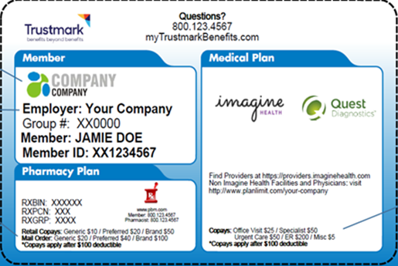

HDHP Basic Plan
Imagine Health & ELAP
This plan option gives you the freedom to choose any provider
Direct access to professional provider network - HealthSmart
Direct access to all Imagine Health providers (Quest)
CVS Minute Clinic for non-urgent care
For non-Imagine providers, ELAP’s Audit Program will ensure you and your plan don’t overpay
ELAP offers strong member advocacy in the event you receive a balance bill from Non-Imagine Providers

Slide 10
Medical – HDHP Basic Plan
 | Imagine Health | All Other Providers
Medical Deductible (single / family) | $1,600 / $3,200 | $2,000 / $4,000
HSA Contribution Match | $250 (if Employee Contributes $250) | $250 (if Employee Contributes $250)
Net Med Deductible w/ Contribution Match | $1,350 / $2,950 | $1,750 / $ 3,750
Benefit Level (Coinsurance) | 100% | 100%
Out-of-Pocket Maximum (single / family) | $4,000 / $8,000 | $4,000 / $8,000
OFFICE VISITS
Primary Doctor Visit | 100% after deductible | 100% after deductible
Specialist Visit | 100% after deductible | 100% after deductible
Preventive Care | 100%, no deductible | 100%, no deductible
Telemedicine (HealthJoy) | N/A | $0 copay
HOSPITAL CARE
Inpatient Hospital Care | 100% after deductible | 100% after deductible
Outpatient Surgery | 100% after deductible | 100% after deductible
Emergency Room | 100% after deductible | 100% after deductible
Urgent Care | 100% after deductible | 100% after deductible
OTHER SERVICES
Lab Services | 100% after deductible | 100% after deductible
Radiology (CT, PET, MRI, MRA) | 100% after deductible | 100% after deductible
Durable Medical Equipment | 100% after deductible | 100% after deductible
Physical Speech and Occupational Therapy (60 visit annual limit) | 100% after deductible | 100% after deductible
Retail (30-day supply) / Mail (up to a 90-day supply) | Generic Preferred: $4 copay after ded. / $10 copay after ded. Generic Non-Preferred: $15 copay after ded. / $38 copay after ded. Brand Preferred: $45 copay after ded. / $113 copay after ded. Brand Non-Preferred: $70 copay after ded. / $175 copay after ded.
Specialty Pharmacy (mail order) | 20% coinsurance up to $600 maximum per prescription

Slide 11
Member Support
Tips and Reminders
Imagine Health Provider
Non-Imagine Providers
Member Support
  You won’t be billed for more than your patient responsibility
  Visit providers.imaginehealth.com
  CVS MinuteClinics® for non-urgent care
  Quest Diagnostics for lab services
  Built-in price protection provided by ELAP Services
  Watch your mail and send any balance bills to Luminare Health
  ELAP’s member advocacy team will provide updates and ongoing support
  Call the number on your benefits ID card when you:
    Have questions about benefits or coverage
    Need help choosing the right healthcare provider

Slide 12
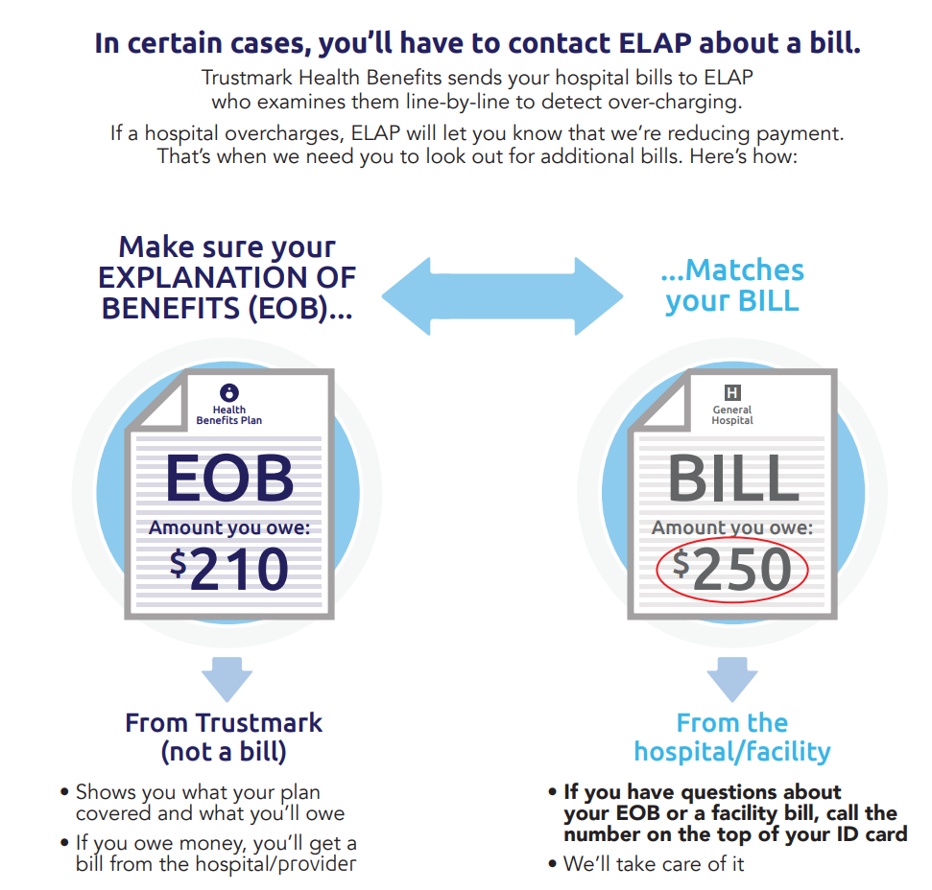
HDHP Basic Plan
Imagine Health & ELAP

Slide 13
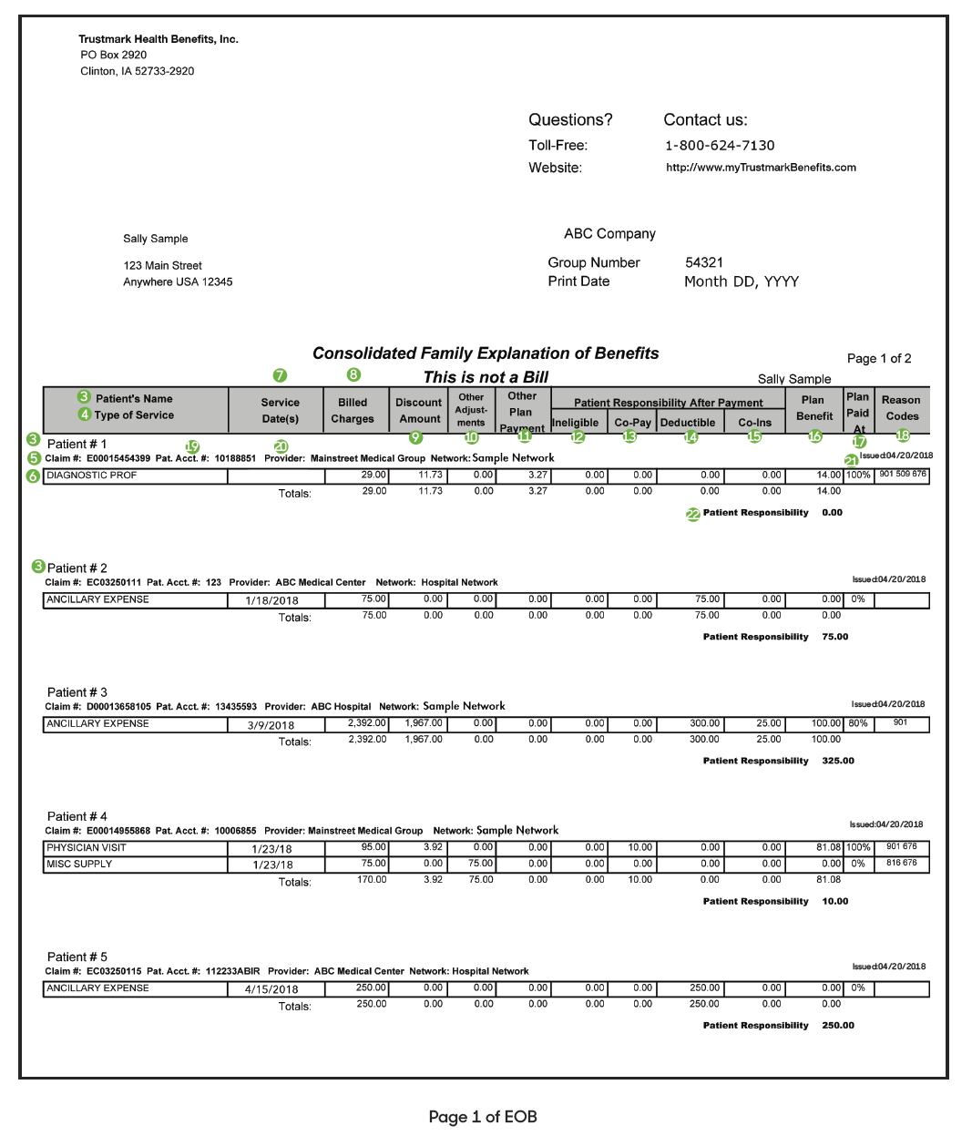
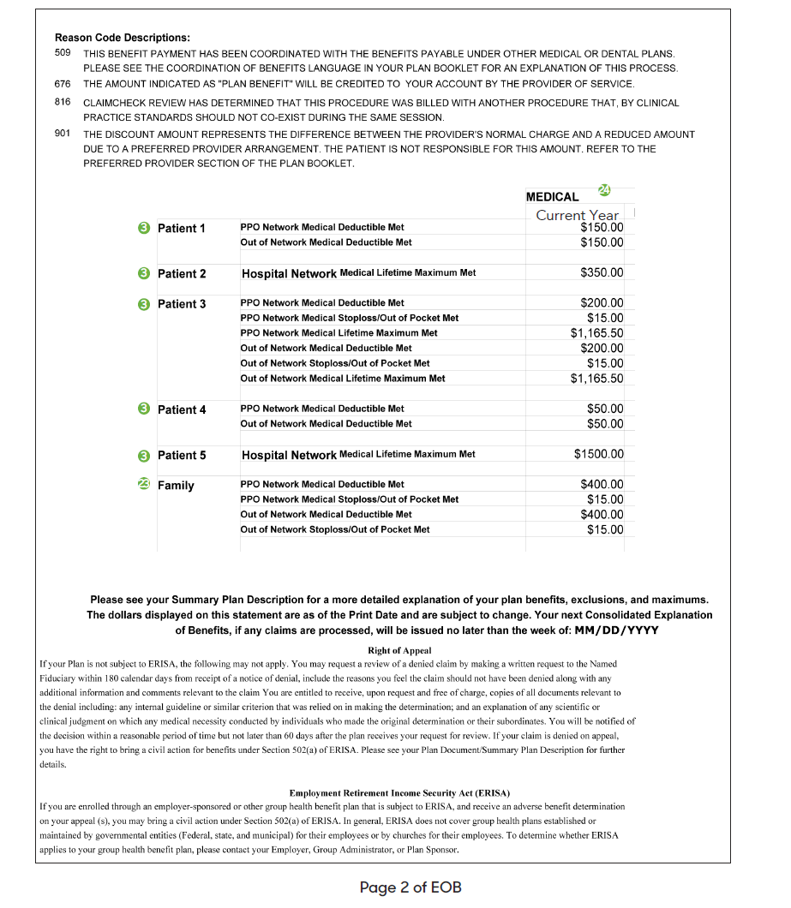
Sample EOB

Slide 14
Employee Contributions
PPO Premium Plan – Highmark Network
Coverage Level | Weekly Cost | Monthly Cost
Employee Only | $33.67 | $145.89
Employee & Spouse | $72.99 | $316.31
Employee & Child | $56.55 | $245.04
Employee & Children | $80.25 | $347.76
Family | $97.29 | $421.61
HDHP Premium Plan – Highmark Network
Coverage Level | Weekly Cost | Monthly Cost
Employee Only | $19.03 | $82.46
Employee & Spouse | $41.39 | $179.37
Employee & Child | $31.98 | $138.59
Employee & Children | $45.84 | $198.66
Family | $54.95 | $238.11
HDHP Basic Plan - RBP
Coverage Level | Weekly Cost | Monthly Cost
Employee Only | $0 | $0
Employee & Spouse | $0 | $0
Employee & Child | $0 | $0
Employee & Children | $0 | $0
Family | $0 | $0

Slide 15
Prescription Safety Glasses Information
American Crane offers coverage for Prescription Safety Glasses under all three Luminare Health Medical Plans!
This benefit is covered under the Medical Insurance as Durable Medical Equipment (DME)
Durable Medical Equipment is covered at 100% after the deductible has been met
All claims for Prescription Safety Glasses will be covered as an In-Network benefit under the plan, whether the provider is considered an:
In-Network Medical provider
Out-of-Network Medical provider
Vision provider
Therefore, even if an Out-of-Network, non-participating provider submits a claim for Prescription Safety Glasses, Luminare will process the claim as in-network.

Slide 16
Prescription Safety Glasses Information
Employees have the following three options when seeking coverage for Prescription Safety Glasses:
Find an In-Network provider for Prescription Safety Glasses. You may need to expand your mile radius in order to locate a provider who participates.
Find an Out-of-Network Medical provider for Prescription Safety Glasses. Ask the non-participating provider to submit the claim to Luminare Health. Luminare will process the claim as in-network.
Find a Vision provider for Prescription Safety Glasses. Ask the Vision provider to submit the claim to Luminare Health. Luminare will process the claim as in-network.

Slide 17
LUMINARE HEALTH RESOURCES

Slide 18
Luminare Health Member Services
Call the number on your ID card – Luminare will direct you!
Luminare customer service will handle member calls related to:
Benefit Coverage
Member Cost-Sharing
EOB’s
Check Information
Audit Packages (ELAP refers the pricing applied to a claim as an 'Audit Package’)
Assist members with finding a provider using the ELAP Guide Services application.
Calls received from members regarding balance billing relating to a date of service priced by ELAP are warm transferred to ELAP.

Slide 19
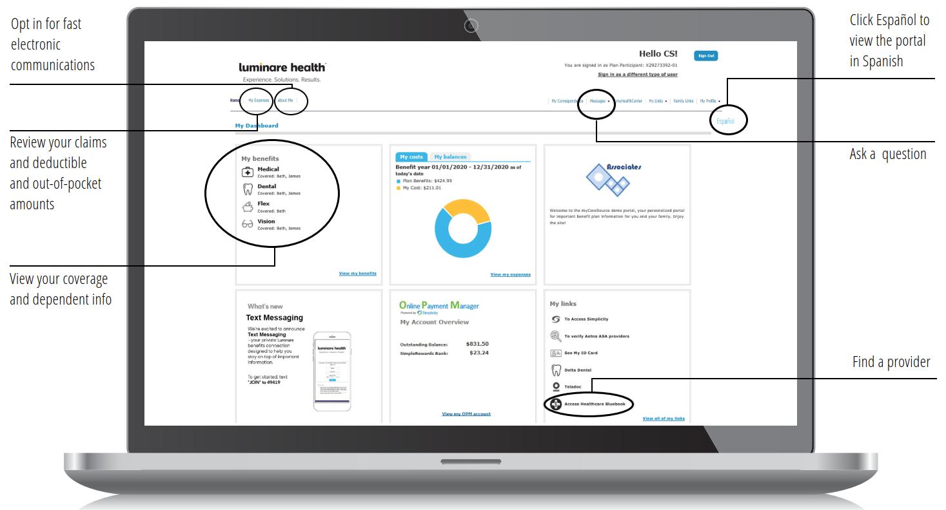
Luminare Health Online Portal

Slide 20
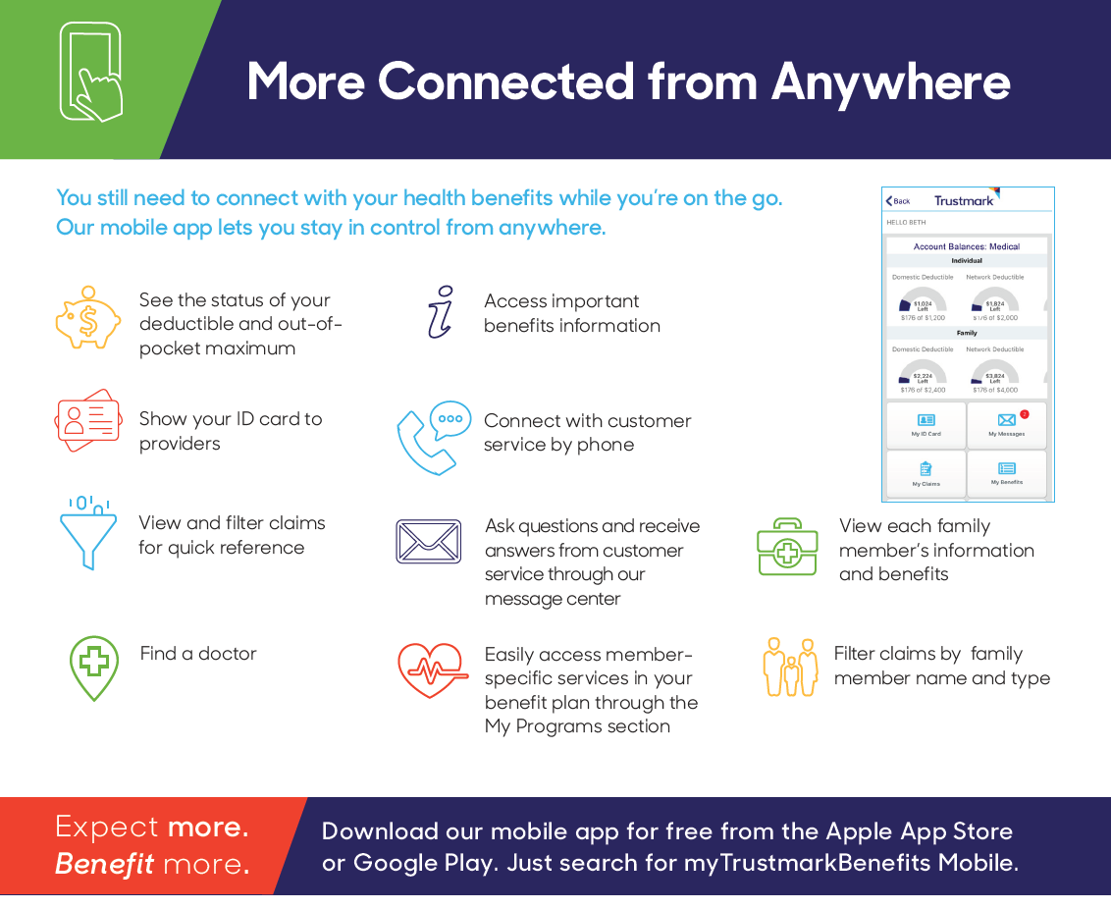
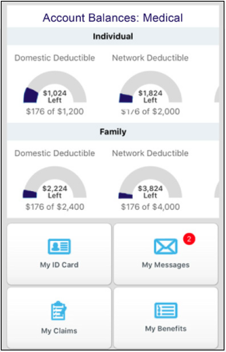

Luminare Health App

Slide 21
HEALTH SAVINGS ACCOUNT (HSA)

Slide 22
Health Savings Account (HSA)
HSA – pre-tax financial account used to pay for qualified Medical and Rx expenses!
HSAs are employee-owned – Funds you deposit are yours to keep!
2025 Maximum Annual Contribution ($4,300 Single; $8,550 Family)
Additional catch-up contributions from age 55-65 of $1,000
Funds are accessed on a pay-as-you-go basis
You can only access funds that have been deposited into the account
NO “Use it or Lose It.” Stays with you when you change jobs or retire
Ameriflex is the HSA administrator
HSA offers Triple Tax Savings to You.
Tax Free contributions.
Tax Free to use to pay for eligible healthcare expenses.
Tax Free interest on unused funds that roll over from year to year.
Please be aware that making contributions while ineligible can result in tax penalties. If you are approaching (or older than) age 65, you should make time to discuss your HSA contribution strategy with a tax advisor.

Slide 23


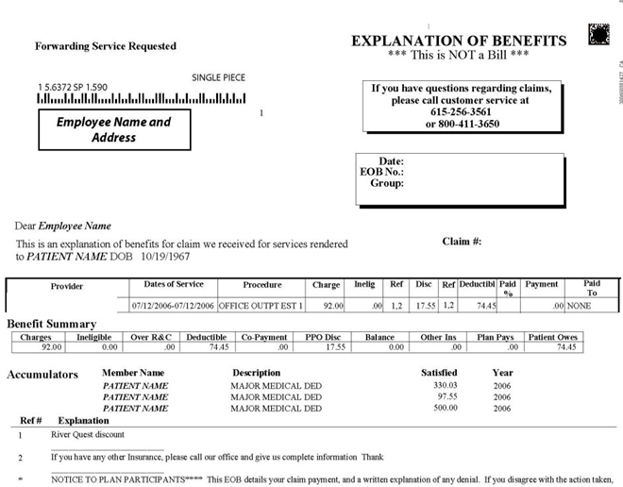

Using the HSA for Medical
ELAP audits/reviews the bill & notifies Luminare*
Luminare sends adjusted claim to provider, who generates invoice
Present your ID Card
Complete Visit
The Provider will submit the claim
Reminders:
  Do not pay on the date of service
  Wait until you receive the Explanation of Benefits (EOB) from the carrier – Review your EOB to make sure it matches the provider bill
    THE ONLY ITEM YOU SHOULD PAY FOR AT TIME OF SERVICE IS PRESCRIPTIONS
Pay with your HSA Card
  *If elect 3rd plan option (HDHP Basic Plan)

Slide 24


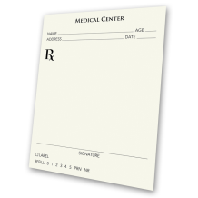

Using the HSA for Rx
Doctor writes a Prescription
Bring Rx to pharmacy
Pharmacist advices price of Rx
You pay Pharmacy with HSA card

Slide 25
Illustrative Cost Comparison:
Low Utilizer
Services | PPO Premium Plan | HDHP Premium Plan | HDHP Basic Plan
2 PCP Visits | $60 | ~ $180 | ~$144
2 Specialist Visits | $100 | ~ $560 | ~ $448
4 Months Supply of Generic Medication | $16 | ~ $50 | ~ $40
Total Cost of Services | $176 | $790 | $632
HSA Dollars Available (Single) * Employer Contribution Amount | - | - | $250*
Member Responsibility | $176 | $790 | $382
Annual Payroll Contribution (Employee Only) | $1,440 | $720 | $0
Total Member Cost | $1,616 | $1,510 | $382
*If employee contributes at least $250
*If an employee contributes at least $250 to their HSA on the HDHP Basic Plan, American Crane will match this contribution with $250. This contribution has a 90-day probationary period for new hires.

Slide 26
Illustrative Cost Comparison:
High Utilizer
Services | PPO Premium Plan | HDHP Premium Plan | HDHP Basic Plan
3 PCP Visits | $90 | ~ $270 | ~ $216
12 Months Supply of Generic Medication | $48 | ~ $150 | ~$120
3 Specialist Visits | $150 | ~ $840 | ~ $672
1 Inpatient Stay (3 days) | $212 (deductible hit) | ~ $740 (deductible hit) | ~ $992
Total Cost of Services | $500 | $2,000 | $2,000
HSA Dollars Available (Single) *Employer Contribution Amount | - | - | $250*
Member Responsibility | $500 | $2,000 | $1,750
Annual Payroll Contribution (Employee Only) | $1,440 | $720 | $0
Total Member Cost | $1,940 | $2,720 | $1,750
*If an employee contributes at least $250 to their HSA on the HDHP Basic Plan, American Crane will match this contribution with $250. This contribution has a 90-day probationary period for new hires.

Slide 27
PRESCRIPTION DRUGS (Rx)

Slide 28
RxBenefits
Pharmacy benefits will be administered by RxBenefits in partnership with Express Scripts
  The RxBenefits service model delivers enhanced safety, better cost savings, and top-notch customer service
  With Express Scripts, you’ll have access to a massive network of more than 60,000 pharmacies nationwide
Member Services: Can be reached at (800) 334-8134 or RxHelp@rxbenefits.com Monday through Friday from 8:00 a.m. to 9:00 p.m. EST. After hours you may choose to transfer directly to Express Scripts.
Digital Tools: Register at express-scripts.com and download the Express Scripts mobile app to manage your profile, request refills, locate pharmacies, and more!
ID Card: Luminare will provide your prescription benefit ID Card. Use your ID card when filling a prescription.
Prior Authorization: Certain medications require PA before the prescription can be filled. The PA review process helps ensure FDA prescribing guidelines are met and that you receive the safest and most appropriate drug therapy. If you currently take a medication requiring a PA, you may need to secure a new one. Be sure to keep a two-week supply on hand and contact RxBenefits at (800) 334-8134 to confirm whether a new PA is required.
Maintenance Medications: Treat ongoing conditions like diabetes, high blood pressure, and asthma. In addition to local retail pharmacy access, your prescription benefit coverage allows these medications to be filled by mail.
Mail Order Provides:
  Free delivery to your home of up to a 90-day supply
  Confidential, tamper-resistant, and temperature-controlled packaging
  Convenient refill requests online or by phone
  24/7 access to a registered pharmacist
  New or initial orders may take 10-14 business days to process. Be sure to have at least a two-week supply on hand when submitting a new Mail Order request.

Slide 29
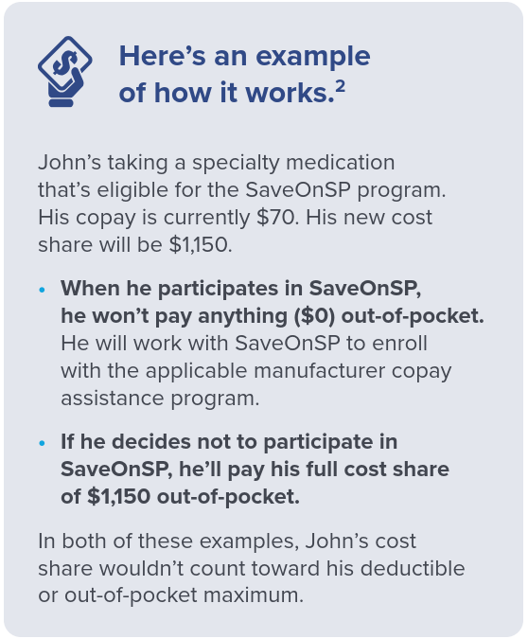
SaveOnSP
Specialty medications can cost a lot of money. That’s why your plan offers a program called SaveOnSP, to lower your out-of-pocket costs to $0.
Over 300 specialty medications are eligible for the SaveOnSP program.
Conditions covered by SaveOnSP include, but are not limited to:
Hepatitis C
Multiple Sclerosis
Psoriasis
Inflammatory Bowel Disease
Rheumatoid Arthritis
Cancer
If you’re filling an eligible medication, a representative from SaveOnSP will contact you to discuss the program.

Slide 30
ADDITIONAL BENEFITS

Slide 31

(NEW!) Dental Plan
Benefit Overview | In-Network | Out-of-Network
Annual Deductible | $50 Single / $150 Family
Annual Maximum | $2,000 per member in-network (DentalGuard Preferred) $2,000 per member out-of-network
Covered Services | In-Network | Out-of-Network
Preventative | 100% | 100%
Basic | 80% | 80%
Major | 50% | 50%
Orthodontia (up to age 19) | 50% | 50%
Lifetime Ortho Maximum | $1,500
Guardian Dental - Employee Contributions
Coverage Level | Weekly Cost | Monthly Cost
Employee Only | $6.89 | $29.84
Employee + 1 | $12.44 | $53.90
Employee + 2 or > | $21.06 | $91.25

Slide 32

Vision Plan
Covered Services | Participating Providers | Non-Participating Providers
Vision Exam (every 12 months) | $10 copay | $40 Allowance
Frames (every 12 months) | $130 Retail Allowance | $50 Allowance
Fashion Level | 100%
Designer Level | 100%
Premier Level | $25 copay
Lenses (every 12 months)
Single | 100% after $25 copay | $40 Allowance
Bifocal | 100% after $25 copay | $60 Allowance
Trifocal | 100% after $25 copay | $80 Allowance
Lenticular | 100% after $25 copay | $100 Allowance
Contacts in lieu of glasses | $130 Material Allowance | $105 Allowance
Medically Required Contacts | 100% | $225 Allowance

Slide 33
Flexible Spending Account
FSA Type | Election Limit | Description
Health Care | $3,300 | Pre-tax dollars that can be used to pay for eligible medical expenses such as plan deductibles, doctor copayments, prescriptions, dental and vision services. The full FSA election amount is available as of the FSA effective date.
Dependent Care | $5,000 | Pre-tax dollars that can be used for eligible child and adult daycare expenses. Both the employee and spouse must be working in order to utilize this FSA. Funds are accessed only as they are deducted from your pay.
Offered through Ameriflex
FSAs are subject to the “use it or lose it” rule!
  Employees can carry over $500 of unused Healthcare FSA funds
  There is a 2.5-month grace period for the Dependent Care FSA
  A 90-day run-out period

Slide 34
HSA vs FSA
 | HSA | Health FSA
Definition | Tax-advantaged savings account | Tax-advantaged savings account
Owned by | Employee | Employer
Contribution from | Employee | Employee
Pre-Tax Dollars | Yes | Yes
Rollover/Portability | Yes | Only $500
Employees can rollover up to $500 of their medical FSA from year to year
Please Note – You cannot contribute to an FSA account if you are enrolled in the HSA. You can contribute to Limited Purpose FSA, which is reserved for employees who are enrolled in a Health Savings Account. This account is to be used on eligible vision and dental expenses only

Slide 35
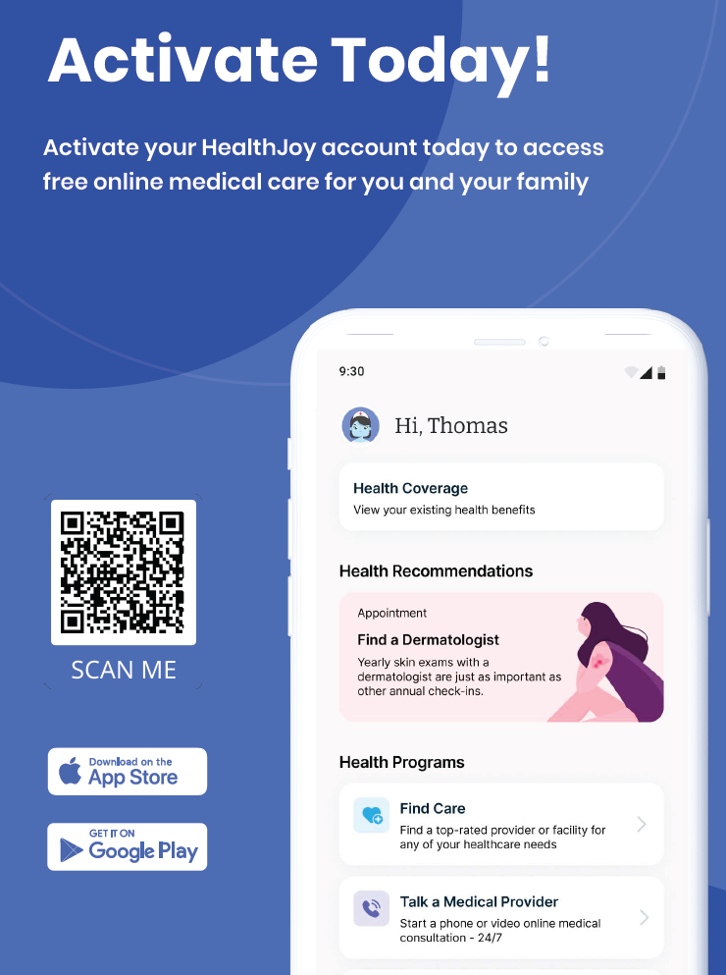
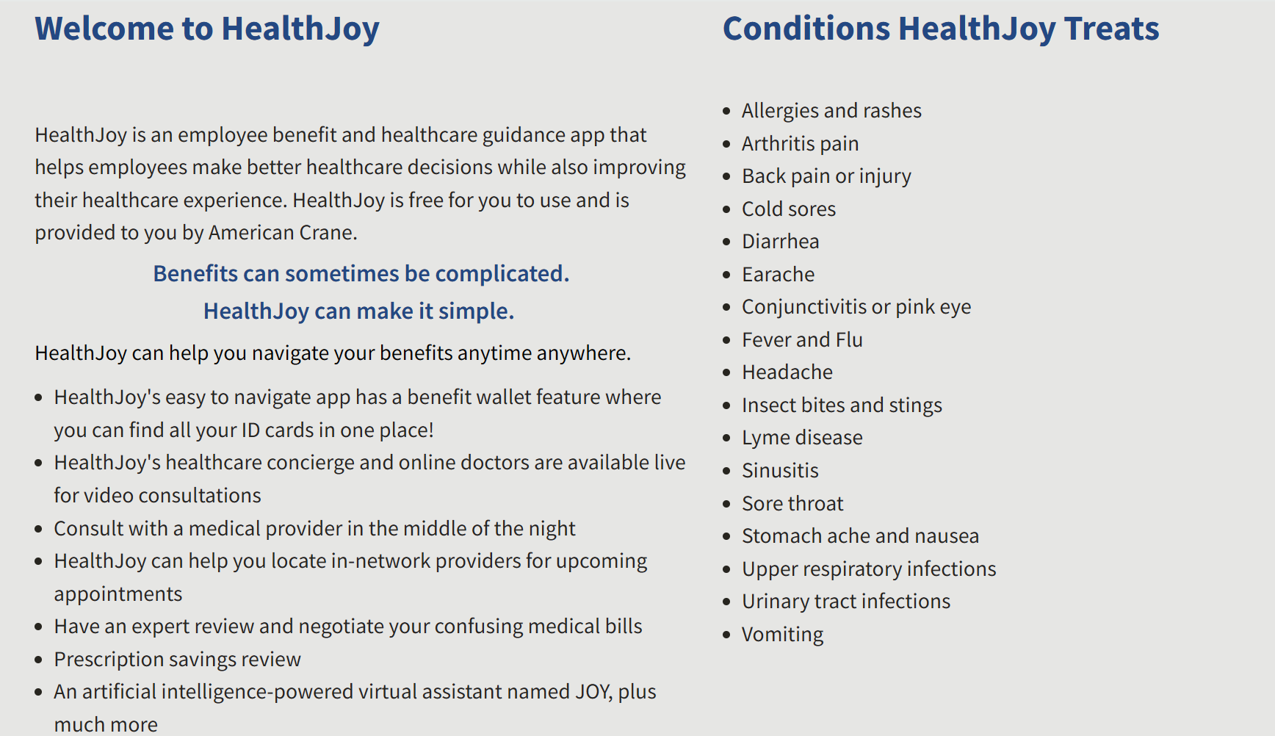







HealthJoy
Personalized Benefits Wallet
Provider Recommendations
Procedure and Facility Recommendations
Rx Savings Review
Medical Bill Review
Telemedicine
Appointment Booking

Slide 36
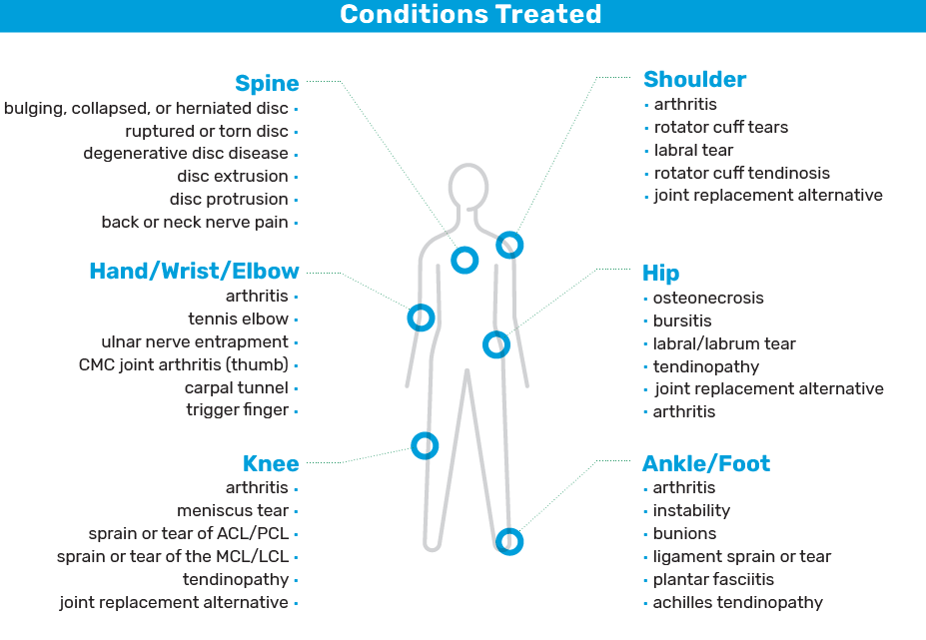
Regenexx® is a covered benefit
Regenexx® invented the field of Interventional Orthopedics, a medical specialty that uses regenerative medicine to treat a broad range of orthopedic conditions. Regenexx® provides an innovative, non-surgical relief, to treat damaged bone, cartilage, muscles, tendons, and ligaments through outpatient procedures that prevent up to 70% of patients from continuing to elective orthopedic surgery
  For more information, call (866) 936-5811
  or visit regenexxbenefits.com/americancrane

Slide 37

Life Insurance
Company Paid Life and AD&D Insurance
Basic Life Benefit | Varies by Class
Basic AD&D Benefit | Varies by Class
Reduction Schedule | At Age 70, 35% reduction At Age 75, 50% reduction
Supplemental Life and AD&D Insurance
Supp Life/ AD&D Benefit | Employee: Increments in $10,000 Spouse: Increments in $5,000 Children: Increments in $1,000 (birth to 1 month) or $10,000 (1 month to 26 years)
Guaranteed Issue for Supp Life | Employee: $50,000 Spouse: $25,000 Children: All GI
Supp Life/AD&D Benefit Maximums | Employee: Lesser of 5x annual earnings or $500,000 Spouse: Lesser of 50% of your amount of insurance or $250,000 Children: $10,000

Slide 38
Disability Insurance
Short-Term Disability
Purpose of Insurance | STD coverage continues a percentage of your regular pay if you become injured or ill due to a non-occupational illness or injury and cannot work
Employee Contribution Required | No, 100% paid by American Crane
Waiting Period | Employees become eligible for Short-Term Disability after 90 days of employment
Elimination Period | 0 days for accident / 7 days for sickness
Benefit Amount | 66 2/3% of base weekly salary; up to $1000 per week
Benefit Duration | 26 weeks
Long-Term Disability
Purpose of Insurance | For enduring, serious non-work-related illnesses or injuries that prevent you from working longer than 180 days
Employee Contribution Required | Yes, 100% paid by employees
Waiting Period | Employees become eligible for Long-Term Disability immediately
Elimination Period | 180 days
Benefit Amount | Units of $100 to $7,500 (not to exceed 60% of monthly earnings)
Benefit Duration | Until SSNRA

Slide 39

Voluntary Benefits
Accident Insurance is designed to help you meet those out-of-pocket expenses and extra bills that can follow even ordinary accidents. In addition to providing coverage choices for you and your family, your base policy is guaranteed renewable for life as long as premiums are paid on time. This plan also includes a $60 wellness benefit per insured per calendar year.
Critical Illness Insurance pays a lump sum benefit up to 100% of the face amount if you or a covered family member is diagnosed with a covered critical illness including cancer, heart attack, stroke, major organ transplant, end-stage renal failure and coronary artery bypass surgery. The benefit can be used any way you choose, and you don’t have to be disabled or terminally ill to receive the benefits. Critical Illness also includes a $50 wellness benefit per insured per calendar year.
Cancer Insurance is a supplemental policy that provides meaningful direct and indirect medical benefits to your employees to help pay the costs of cancer treatment. Cancer Select Plus benefits are paid in addition to any other insurance your employees may have. Benefits are paid directly to the employee or directly to anyone else he or she chooses. Cancer Select Plus also includes a cancer screening wellness rider that pays a $100 benefit per calendar year to each insured for specific tests performed to determine whether cancer exists in an insured person.
Hospital Indemnity is designed to help provide financial protection for covered individual by paying a benefit due to a hospitalization. Employees can use the benefit to meet the out-of-pocket expenses and extra bills that can occur. Indemnity lump sum benefits are paid directly to the employee based on the amount of coverage listed, regardless of the actual cost of treatment.
Universal Life Insurance can be used to help you meet long-term financial goals. Universal Life Insurance provides death benefit protection and builds cash value, while offering flexibility to meet your changing needs. Cash value accumulations are tax-deferred under current federal income tax laws and earn a competitive rate of interest.
Please sign up for a one-on-one consultation –
Doug Easlick
DEaslick@grahamco.com
(610) 715-1360

Slide 40

Genomic Life
Genetic Health Screen
Informs genetic predisposition
for actionable conditions
Carrier Screening
Identifies critical recessive
traits for expectant parents
Pharmacogenomics
Highlights drug-gene
interactions and efficacy
Analyzes 147 genes,
identifying elevated
health risks for cancer,
cardiac disease, and
other critical illnesses
Uncovers genetic insights
from both partners during family planning which help mitigate the risk of serious illness in offspring
Analyzes the unique way
an individual responds to medications to optimize treatment, maximize effectiveness, and
minimize side effects
Notes:
TK
49% matched therapy
https://jamanetwork.com/journals/jamanetworkopen/fullarticle/2765937
https://www.fda.gov/drugs/science-and-research-drugs/table-pharmacogenomic-biomarkers-drug-labeling
100% have variants that can cause disease in a child
2% of births have a complication from a genetic condition
16% have a variant that increases risk for an actionable condition
90% have variants affecting response to medications
480 drugs with biomarkers across ~20 therapeutic areas

Slide 41
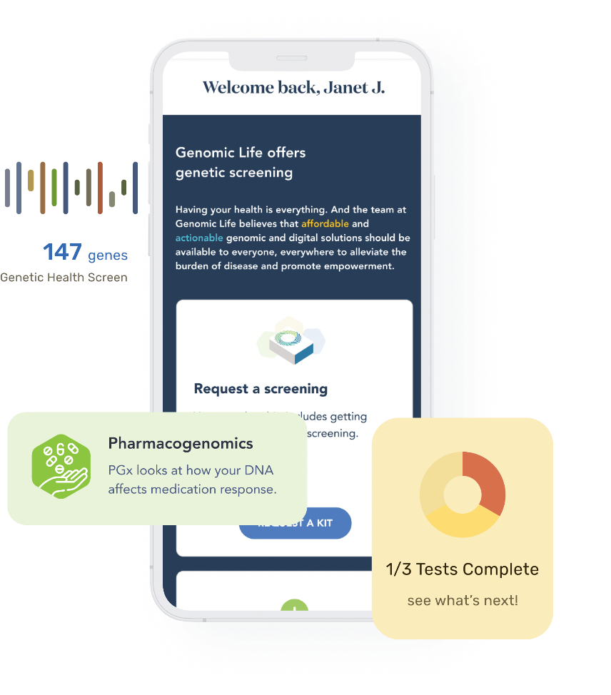
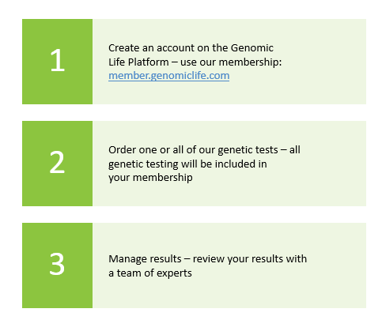
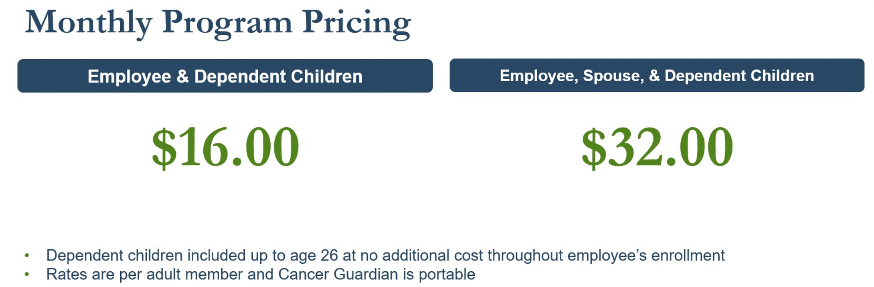
Genomic Life

Slide 42
Wishbone Pet Insurance
Comprehensive Accident and Illness plan
  Optional Wellness Plans can be added to an accident and illness plan or selected on their own
Can be used at any veterinary facility, including specialty and emergency clinics
Covers dogs and cats from 7 weeks of age, with no upper age restriction
Rate is based on age, breed and zip code
  Includes 5% group discount
  Additional 5% discount available when you enroll 2+ pets
Get a quote and enroll at www.wishboneinsurance.com/americancrane
Notes:
TK
49% matched therapy
https://jamanetwork.com/journals/jamanetworkopen/fullarticle/2765937
https://www.fda.gov/drugs/science-and-research-drugs/table-pharmacogenomic-biomarkers-drug-labeling
100% have variants that can cause disease in a child
2% of births have a complication from a genetic condition
16% have a variant that increases risk for an actionable condition
90% have variants affecting response to medications
480 drugs with biomarkers across ~20 therapeutic areas

Slide 43

Medicare Support
Company-sponsored benefit available to you and your dependents for assistance and advice regarding Medicare coverage, benefits or general questions you may have.
Services Include:
A short fact finder to collect details on your specific situation and needs.
Transition from the Group Health Plan to Original Medicare and Medicare Supplemental Insurance.
Helpful timeline as to when to contact Social Security regarding coverage and benefits under Medicare, Medicare Supplemental Insurance, Prescription Drug Plans and Medicare Advantage.
HTA Financial can help with guidance and support for choosing appropriate coverages to meet your needs as well as enrollment assistance in a plan if you choose to enroll.
HTA encourages you to have your current prescription medications handy when contacting HTA Financial!
  610-430-6650, option 1
  Medicare@HTAfinancial.com

Slide 44

Employee Assistance Program
Ulliance’s Employee Assistance Program (EAP) is available to all employees, spouses, and dependents through age 26 at no cost!
Call (800) 448-8326 to get connected to an Ulliance Life Advisor
  Crisis support is provided 24/7
Short Term Focus Counseling
  Connect with a Life Advisor for short term, solution focused support for work-life issues such as stress, major life transitions, relationship issues, substance use, grief/loss, and overwhelming emotions.
Coaching through Ulliance
  Goals for Self-Improvement
  Inspiration and Motivation
Legal Consultations
  You can receive a 30-minute legal consultation with an attorney who specializes in the area of law you need as well as other resources. Your initial consultation is provided at no cost and if you hire the attorney for ongoing services, you will receive a 25% discount
Financial Consultations
  Talk to a certified financial planner about budgeting, debt consolidation, or other financial planning services
  Initial consultation is provided at no cost, and a 15% discount is provided for follow up consultations
Child/Elder Care Consultation Services, ID Theft/Credit Monitoring, and additional Discount Programs are also offered through Ulliance!

Slide 45
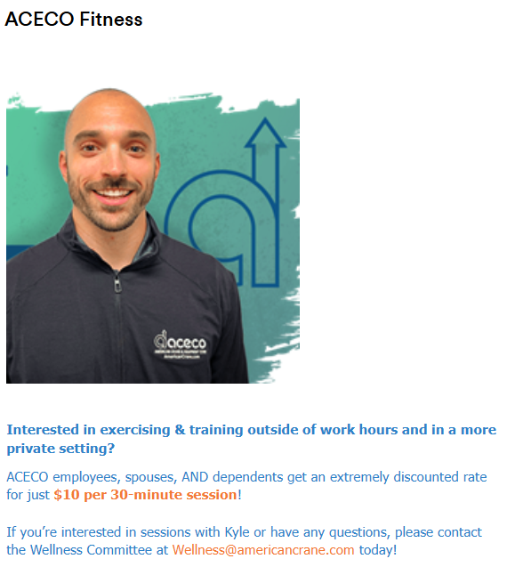
ACECO FITNESS

Slide 46

Customer Service Resources

Slide 47

The Graham Company provides an Employee Benefits Service Line to assist employees with inquiries related to:
  Claim Payments
  Coverage Explanations
  Eligibility
  Any other issue or question you cannot resolve when you contact the insurance company directly
Employee Benefits Service Line is staffed Monday through Friday, 9:00 AM to 5:00 PM EST.
Toll Free 1-888-842-1488
TGCBenefits@grahamco.com

Slide 48

401(k) Contact Information
Phone: 717.741.0469
Email: ventrek@fnb-corp.com

