Slide 1

Open Enrollment 2025
Plan Year beginning January 1, 2025
Enroll December 2nd – 9th

Slide 2
What is Open Enrollment?
Once enrolled, you will not be able to make changes or cancel coverage until the next Annual Open Enrollment period!
Qualified Life events
  Marriage
  Birth, adoption
  Change in job status
  Change in Medicare status
Make changes to benefits
Add or remove dependent(s)
Enroll in coverage for the first time
Waive coverage previously elected
12/2/24 – 12/9/24
All enrollments must be completed by
December 9th, 2024

Slide 3
Overview
Key Points for 2025
Medical Plan Options
Supplemental Benefits
Spending Accounts
Customer Service Resources

Slide 4
Key Benefit Points for 2025
Enrolling in benefits during this Open Enrollment period:
  Elections for all plans effective January 1, 2025 (through 12/31/2025)
  This is an ACTIVE enrollment. You MUST make elections for medical, dental, and vision, and voluntary benefits through Paylocity
    If you wish to contribute/continue contributing to the Health Savings Account (HSA) for 2025 you MUST elect your 2025 contribution through Paylocity
CastleWorks will be offering five NEW medical plans through UnitedHealthcare (UHC) and one new plan through Kaiser Permanente
  3 HMO Plan Options: SV Harmony HMO, SV Alliance HMO, and the SV HMO
  2 Select Plus Plan Options: Select Plus and Select Plus HSA
    These five medical plans are replacing the previously offered Blue Shield of California medical plans
  Kaiser HDHP 3300 with Health Reimbursement Arrangement (HRA)
CastleWorks is offering three new Voluntary Benefit offerings:
  Accident Insurance
  Critical Illness Insurance
  Hospital Indemnity Insurance
The Kaiser 1500 medical plan will continue to be offered

Slide 5
Medical Plans

Slide 6

Medical SV HMOs –
 | SV HARMONY HMO | SV ALLIANCE HMO | SV HMO
Medical Deductible (single / family) | $2,000 / $4,000 | $1,500 / $3,000 | $2,000 / $4,000
Benefit Level (Coinsurance) | 70% | 70% | 70%
Out-of-Pocket Maximum (single / family) | $5,000 / $10,000 | $4,000 / $8,000 | $5,000 / $10,000
OFFICE VISITS
Primary Doctor Visit | $25 Copay | $30 Copay | $25 Copay
Specialist Visit | $50 Copay | $60 Copay | $50 Copay
Preventive Care | Covered 100% | Covered 100% | Covered 100%
HOSPITAL CARE
Inpatient Hospital Care | You pay 30%, after deductible | You pay 30%, after deductible | You pay 30%, after deductible
Outpatient Surgery | You pay 30%, after deductible | You pay 30%, after deductible | You pay 30%, after deductible
Emergency Room | You pay 30%, after deductible | You pay 30%, after deductible | You pay 30%, after deductible
OTHER SERVICES
Complex Imaging | $150 Copay | $150 Copay | $150 Copay
Radiology | $25 Copay | $25 Copay | $25 Copay
Urgent Care | $25 Copay | $30 Copay | $25 Copay
PRESCRIPTION DRUG
Retail (30-day supply)
RX Deductible (single / family) | Integrated w/ Medical | Integrated w/ Medical | Integrated w/ Medical
Generic | $10 Copay | $10 Copay | $10 Copay
Formulary | $35 Copay | $35 Copay | $35 Copay
Non-Formulary | $70 Copay | $70 Copay | $70 Copay
Mail Order (90-day supply) | 2.5X Retail Copay | 2.5X Retail Copay | 2.5X Retail Copay
No Out-of-Network Coverage available

Slide 7
Medical Select Plus –
 | In-Network | Out-of-Network
Medical Deductible (single / family) | $4,000 / $8,000 | $12,000 / $24,000
Benefit Level (Coinsurance) | 70% | 50%
Out-of-Pocket Maximum (single / family) | $7,000 / $14,000 | $21,000 / $42,000
OFFICE VISITS
Primary Doctor Visit | $35 Copay | You pay 50%, after deductible
Specialist Visit | $70 Copay | You pay 50%, after deductible
Preventive Care | Covered 100% | N/A
HOSPITAL CARE
Inpatient Hospital Care | You pay 30%, after deductible | You pay 50%, after deductible
Outpatient Surgery | You pay 30%, after deductible | You pay 50%, after deductible
Emergency Room | You pay 30%, after deductible | You pay 30%, after deductible
OTHER SERVICES
Complex Imaging | $150 Copay | You pay 50%, after deductible
Radiology | $25 Copay | You pay 50%, after deductible
Urgent Care | $25 Copay | You pay 50%, after deductible
PRESCRIPTION DRUG
Retail (30-day supply)
RX Deductible (single / family) | Integrated w/ Medical | Integrated w/ Medical
Generic | $15 Copay | $15 Copay
Formulary | $35 Copay | $35 Copay
Non-Formulary | $70 Copay | $70 Copay
Mail Order (90-day supply) | 2.5X Retail Copay | 2.5X Retail Copay
Out-of-Network Coverage is available. However, utilizing in-network providers will maximize your medical benefit.

Slide 8
Medical Select Plus HSA –
 | In-Network | Out-of-Network
Medical Deductible (single / family) | $7,000 / $14,000 | $14,000 / $28,000
Benefit Level (Coinsurance) | 100% | 100%
Out-of-Pocket Maximum (single / family) | $7,000 / $14,000 | $14,000 / $28,000
OFFICE VISITS
Primary Doctor Visit | You pay 0%, after deductible | You pay 0%, after deductible
Specialist Visit | You pay 0%, after deductible | You pay 0%, after deductible
Preventive Care | Covered 100% | N/A
HOSPITAL CARE
Inpatient Hospital Care | You pay 0%, after deductible | You pay 0%, after deductible
Outpatient Surgery | You pay 0%, after deductible | You pay 0%, after deductible
Emergency Room | You pay 0%, after deductible | You pay 0%, after deductible
OTHER SERVICES
Complex Imaging | You pay 0%, after deductible | You pay 0%, after deductible
Radiology | You pay 0%, after deductible | You pay 0%, after deductible
Urgent Care | You pay 0%, after deductible | You pay 0%, after deductible
PRESCRIPTION DRUG
Retail (30-day supply)
RX Deductible (single / family) | Integrated w/ Medical | Integrated w/ Medical
Generic | $10 Copay, after deductible | $10 Copay, after deductible
Formulary | $35 Copay, after deductible | $35 Copay, after deductible
Non-Formulary | $70 Copay, after deductible | $70 Copay, after deductible
Mail Order (90-day supply) | 2.5X Retail Copay | 2.5X Retail Copay
Out-of-Network Coverage is available. However, utilizing in-network providers will maximize your medical benefit.

Slide 9
Health Savings Account (HSA)
You can participate in the HSA only if you enroll in the Select Plus HSA.
An HSA is a personal bank account that is yours to keep.
It’s portable. Even if you change jobs, you get to keep your HSA.
You can use your HSA to pay for qualified healthcare expenses.
It allows for an improved retirement account. Funds roll over at the end of each year and accumulate tax-free, as does the interest on the account.
Once you reach the age of 55, you are allowed to make additional “catch-up” contributions up to $1,000 to your HSA until age 65.
2025 ANNUAL CONTRIBUTION LIMITS
$4,300 for Individual / $8,550 for Family
Catch-Up Contributions: $1,000/year (HSA owners 55 and older)
Notes:
$

Slide 10


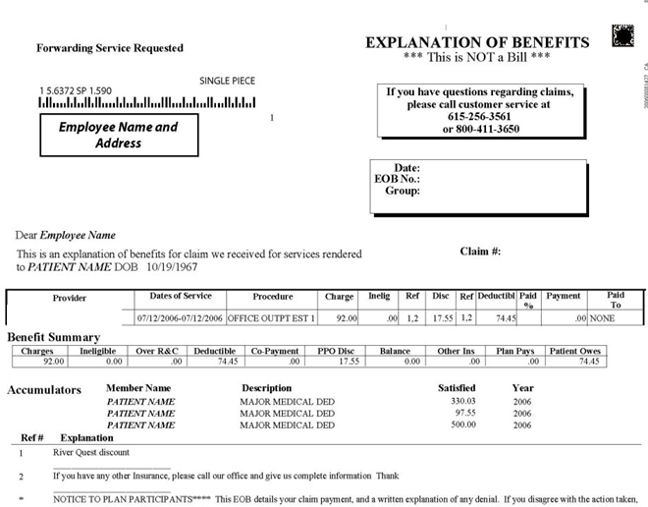

Using the HSA for Medical
UHC will adjust the claim
and will generate EOB
The provider will receive the adjusted claim and generate an invoice for the remaining amount*
Present your UHC ID Card
The Provider will submit the claim to UHC
Complete Visit
Reminders:
  Do not pay on the date of service.
  Wait until you receive the adjusted bill from your provider and the EOB from UHC.
    *If you do not have an HSA balance remaining you will receive a bill from the provider for the remaining amount.
After reviewing your EOB, and the bill, pay the amount due with your HSA card

Slide 11
Selecting a Primary Care Provider (PCP)
If you’re enrolling in an HMO, you must select a Primary Care Provider!
A primary care provider (PCP) is your health guide — someone who can help coordinate your care and supports you in achieving your best health.
Your PCP:
Must be a general practice, family practice, pediatrician or internal medicine provider
Must be an individual provider, not a medical practice
Must be accepting new patients (if you are not a current patient)
Must be located in a town or city near where you live or work
Can be selected for the entire family or each covered member can select their own
If you do not select a PCP, UnitedHealthcare will select one for you. During the month of January (2025), you may change your PCP and have it backdated to January 1st. After January, any PCP changes will not take effect until the 1st of the following month. If the change is made after the 15th of the month, it will not go into effect until the 1st of the month after.
Example: Changing your PCP between March 1-15 → Effective April 1st
Changing your PCP between March 16-31 → Effective May 1st

Slide 12
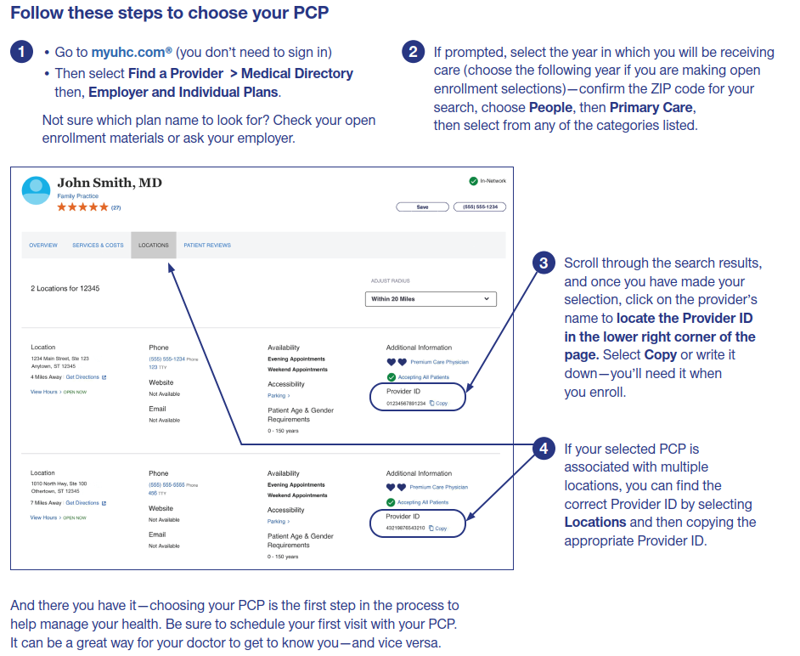

Slide 13

Kaiser HMOs –
 | Kaiser 1500 | (NEW!) Kaiser HDHP 3300
Medical Deductible (single / family) | $1,500 / $3,000 | $3,300 / $6,600
Health Reimbursement Arrangement Funding | N/A | $1,000 / $2,000
Net Employee Deductible | $1,500 / $3,000 | $2,300 / $4,600
Benefit Level (Coinsurance) | 70% | 70%
Out-of-Pocket Maximum (single / family) | $4,000 / $8,000 | $5,350 / $10,700
OFFICE VISITS
Primary Doctor Visit | $40 | $30, after deductible
Specialist Visit | $50 | $50, after deductible
Preventive Care | Covered, 100% | Covered, 100%
HOSPITAL CARE
Inpatient Hospital Care | You pay 30%, after deductible | You pay 30%, after deductible
Outpatient Surgery | You pay 30%, after deductible | You pay 30%, after deductible
Emergency Room | You pay 30%, after deductible | You pay 30%, after deductible
OTHER SERVICES
Complex Imaging | You pay 30%, after deductible (up to $250 max) | You pay 30%, after deductible
Radiology | You pay 30%, after deductible | You pay 30%, after deductible
Urgent Care | $40 | You pay 30%, after deductible
PRESCRIPTION DRUG
Retail (30-day supply)
RX Deductible (single / family) | Integrated w/ Medical | Integrated w/ Medical
Generic | $10 Copay | $15 Copay, after deductible
Formulary | $30 Copay | $30 Copay, after deductible
Non-Formulary | Kaiser Wholesale Price | Kaiser Wholesale Price
Mail Order (90-day supply) | 2X Retail Copay | 2X Retail Copay
No Out-of-Network Coverage available
Notes:
$$

Slide 14
HRA and Deductible
Single
Family
First $3,300 of expenses cover the deductible, of which $1,000 is paid with your HRA
First $6,600 of expenses cover the deductible, of which $2,000 is paid with your HRA
$1,000
CastleWorks pays first portion of deductible
$2,000 CastleWorks pays first portion of deductible
$3,300 Deductible
$6,600 Deductible
$2,300
Employee pays remaining portion of deductible
$4,600
Employee pays remaining portion of deductible

Slide 15
Using the HRA for Medical
Present your Kaiser ID Card
Kaiser will adjust the claim
and will generate EOB
The provider will receive the adjusted claim and generate an invoice for the remaining amount*
Complete Visit
The Provider will submit the claim to Kaiser
Reminders:
  Do not pay on the date of service.
  Wait until you receive the adjusted bill from your provider and the EOB from Kaiser.
    *If you do not have an HRA balance remaining, you will pay the bill using the payment of your choice.
After reviewing your EOB, and the bill, pay the amount due using your Paylocity HRA Card

Slide 16
Preventive Care
Preventive care is covered at 100% on all plans!
  Preventive care = annual exam and lab tests to monitor health and detect potential issues
  Not all exams and tests are considered preventive. Check with your health plan.
TYPICAL SCREENINGS FOR ADULTS | FOR WOMEN, ALSO INCLUDE | FOR MEN, ALSO INCLUDE
Blood pressure Cholesterol Colorectal cancer Diabetes Depression Vaccines STIs | Mammogram and gynecological exams* | Prostate cancer screening and testicular exam*
*Always check with UHC or Kaiser before a Preventive Care visit as there may be age requirements

Slide 17
UHC Medical - Weekly Payroll Deductions
 | HMO SV Harmony | HMO SV Alliance | HMO SV
Employee | $20.63 | $17.90 | $28.53
Employee + Spouse | $129.96 | $153.68 | $253.69
Employee + Child(ren) | $50.65 | $34.47 | $91.19
Family | $151.57 | $159.80 | $307.73
 | Select Plus | Select Plus HSA
Employee | $33.53 | $28.37
Employee + Spouse | $258.61 | $218.16
Employee + Child(ren) | $93.57 | $79.47
Family | $308.27 | $259.92

Slide 18
Kaiser Medical - Weekly Payroll Deductions
 | Kaiser 1500 | (NEW!) Kaiser HDHP 3300
Employee | $24.85 | $13.62
Employee + Spouse | $165.45 | $119.93
Employee + Child(ren) | $84.32 | $44.62
Family | $210.72 | $138.47

Slide 19

Pay Now/Pay Later
When choosing your plan, you can either “pay now” with higher premiums and lower out-of-pocket costs or "pay later” with lower premiums but higher costs when you use services.
The “pay now” plan has higher per paycheck costs and lower out-of-pocket costs, copays, deductibles and out-of-pocket maximums.
Example: Kaiser 1500
Ideal if you go to the doctor frequently
Premiums
Deductible/Out-of-Pocket Costs
The “pay later” plan has lower per-paycheck costs and higher copays, deductibles and out-of-pocket maximums
Example: Kaiser HDHP 3300
A better option if you prefer lower monthly deductions
Deductible/Out-of-Pocket Costs
Premiums

Slide 20
Dental, Vision, Life, and Voluntary Benefits

Slide 21

Dental Benefits –
 | Principal DPPO
BENEFIT OVERVIEW | In-Network | Out-of-Network
ANNUAL DEDUCTIBLE (single/family) | $50 / $150 | $50 / $150
ANNUAL MAXIMUM | $2,250 | $1,750
COVERED SERVICES PREVENTATIVE: Exams, X-rays, Cleanings, Fluoride Treatment | 100% | 100%
BASIC: Palliative Emergency Treatment, Sealants Fillings, Endodontics, Oral Surgery | 90% | 80%
MAJOR: Crowns, Bridges, Dentures, Prosthetics, Inlays/Onlays | 60% | 50%
ORTHODONTIA: Child(ren) only | 50% up to lifetime maximum of $1,500 | 50% up to lifetime maximum of $1,000
EMPLOYEE CONTRIBUTIONS (Weekly) EMPLOYEE ONLY | $8.98
Employee + Spouse | $18.66
Employee + Child(ren) | $23.57
Employee + Family | $34.99

Slide 22
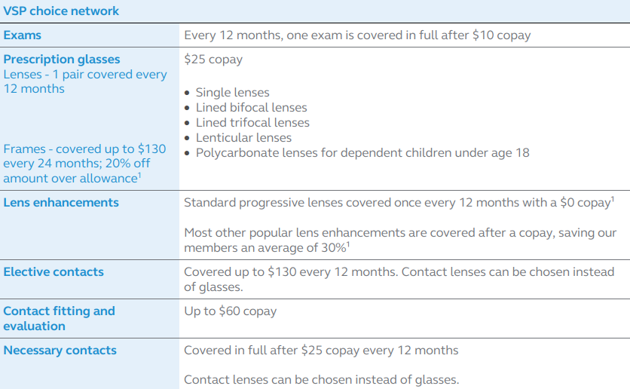
Vision Benefits –
(VSP’s Choice Network)
EMPLOYEE CONTRIBUTIONS (Weekly) EMPLOYEE ONLY | $1.03
Employee + Spouse | $2.24
Employee + Child(ren) | $2.42
FAMILY | $3.91

Slide 23
Life Insurance –
Employer-Paid Basic Life
Basic Life and AD&D Insurance
Benefit | $50,000 (hourly); $100,000 (salary)
Employee-Paid Voluntary Life
Supplemental Life and AD&D Insurance
EE Benefit | $10,000 increments
Guaranteed Issue (GI) – For New Hires/First Time Enrollees | $150,000
Minimum Benefit | $10,000
Maximum Benefit | $250,000
Spouse Benefit | $5,000 increments up to $100,000 maximum (spouse coverage cannot exceed 50% of your own); GI - $30,000
Child | $2,000 increments up to $10,000 maximum
Basic Life Reductions –
At age 70, coverage amount reduces to 50%
Supplemental Life Reductions –
At age 65, coverage amount reduces to 65%
At age 70, coverage amount reduces to 50%
Notes:
Mention EOI

Slide 24
Accident Insurance –
How it Protects
  Provides a lump-sum cash benefit if you or a covered family member is accidently injured
  Covered injuries include broken bones, cuts, burns, eye injuries, ruptured discs, coma, etc.
You can use the payment as you see fit, such as to cover doctor visits, ambulance fees and hospital bills.

Slide 25
Accident Insurance –
Coverage Tier | Weekly Rate
Employee Only | $2.55
Employee + Spouse | $4.17
Employee + Children | $4.70
Employee + Family | $7.38

Slide 26
Critical Illness –
Critical Illness insurance is designed to help employees offset the financial effects of a catastrophic illness with a lump sum cash benefit if an insured is diagnosed with a covered specified disease (heart attack, stroke, invasive cancer, etc.) Payments can be used to cover related expenses, medical or otherwise, including:
  Deductibles, co-pays, hospital bills and other medical expenses
  Childcare or house-sitting for the family pet
  Credit card payments and other household bills
  Travel to out-of-town hospital or treatment facility
  Non-medical expenses like missed work and house-keeping
Employees can select from $5,000 to $100,000 of coverage in increments of $5,000
Spousal coverage can be added from $2,500 to $50,000 (cannot exceed 50% of your own benefit) in increments of $2,500
Children are automatically covered at 25% of the employee’s benefit until age 26

Slide 27
Hospital Indemnity –
This coverage pays benefits when you have an unplanned hospital stay for an illness or injury (minimum of 18 consecutive hours). The plan pays a lump-sum benefit for admission and a daily benefit for a covered hospital stay. You can use the benefits to help pay out-of-pocket medical costs or personal expenses.
Covered Benefit | Pay Out
First Day Hospital – Illness/Injury | $1,000 (Maximum: 1 day per year)
First Day ICU – Illness/Injury | $2,000 (Maximum: 1 day per year)
Hospital Stay - Daily | $100/day (Maximum: 30 days)
Hospital Stay – (ICU) Daily | $200/day (Maximum: 30 days)
Newborn Nursery | $100 (Maximum: 1 day per year)
Am I eligible for benefits if I’m pregnant? If you or your covered dependent experience complications because of your pregnancy or childbirth, benefits will be treated as any other sickness. Benefits would not be payable for a normal pregnancy or childbirth unless you or your covered dependent, have coverage in force for one full day after completion of 10 consecutive months.

Slide 28
Hospital Indemnity –
Coverage Tier | Weekly Rate
Employee Only | $3.34
Employee + Spouse | $11.07
Employee + Children | $5.95
Employee + Family | $14.16

Slide 29
Employee Assistance Resources

Slide 30
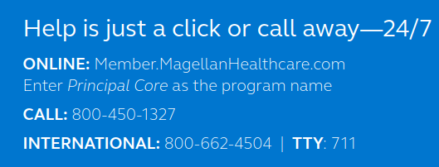
Employee Assistance Program –
In-person or Virtual Counseling | Legal, Financial, and Identity Theft Services | 24/7 Work-Life Web Services
One valuable way to work through personal or work issues is by talking with a professional. Employees and their families can meet with a licensed, EAP professional in-person, via text message, or by live chat, video, or phone sessions. Three counseling sessions per year are included | Employees and their families have access to legal services to help deal with issues such as car accidents or family law. The financial wellness resources provide help with issues such as budget planning or debt consolidation. And identity theft resources can help restore stolen identities. Legal/ID Theft – one free 60-minute consultation Financial Coaching – three free 30-minute consultations | Employees can access webinars, live talks, and articles on topics such as child and elder care, education, parenting, and more.

Slide 31


The Graham Company provides an Employee Benefits Service Line to assist employees with inquiries related to:
  Claim Payments
  Coverage Explanations
  Eligibility
  Any other issue or question you cannot resolve when you contact the insurance company directly
Employee Benefits Service Line is staffed Monday through Friday, 9:00 AM to 5:00 PM EST.
Toll Free 1-888-842-1488
TGCBenefits@grahamco.com

Slide 32
Enrollment Reminders
REMEMBER: Open enrollment is from December 2nd through December 9th
  This is an ACTIVE enrollment. You MUST make elections for medical, dental, and vision, and voluntary benefits through Paylocity.
  If you wish to contribute/continue contributing to the Health Savings Account (HSA) for 2025 you MUST elect your 2025 contribution through Paylocity
Update Beneficiary Information
Log into Paylocity to enroll in coverage!
Reminder – You will have to wait until our 2026 Open Enrollment to make changes to your benefits unless you have a qualifying life event.

Slide 33
Questions?

