Slide 1
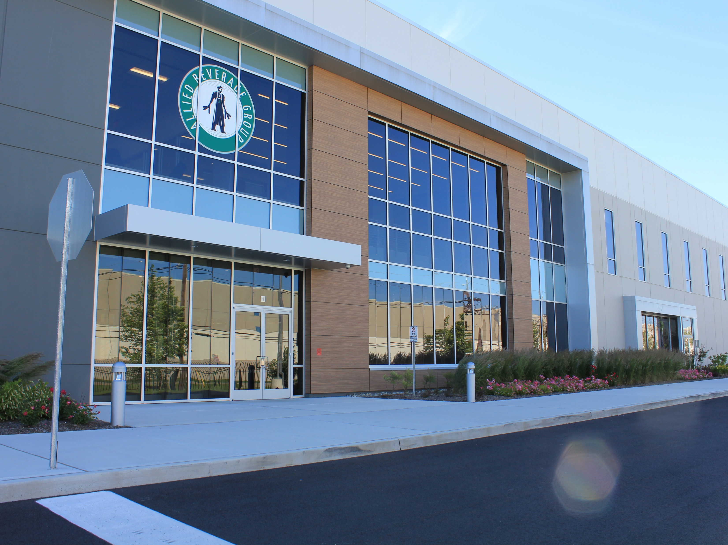

2025 Open Enrollment
May 27th – June 13th

Slide 2
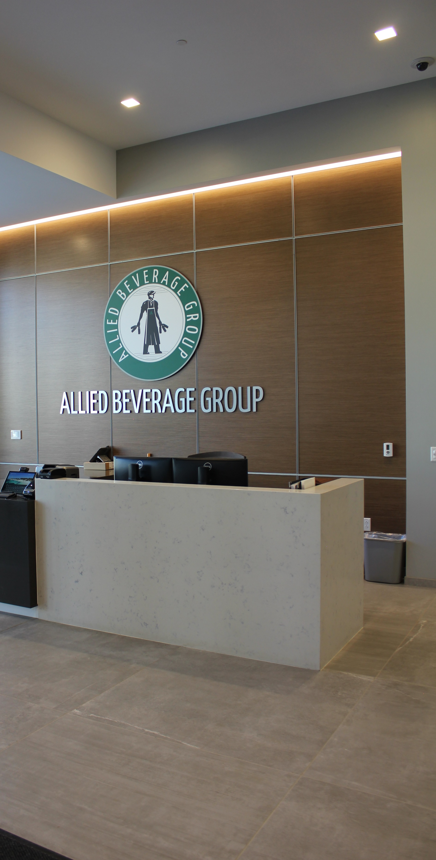
Agenda
Highlights and FAQs
How to Enroll
Meritain and SmithRx Transition
Medical Plan Overview
Health Savings Account (HSA)
Dental and Vision Benefits
Flexible Spending Accounts
Life and Disability
Voluntary Benefits
Customer Service Resources

Slide 3
Open Enrollment Highlights
ACTIVE ENROLLMENT You MUST complete your enrollment in ABG Connect between May 27 and June 13, 2025. If you do not log into ABG Connect and complete your enrollment, your benefits will NOT carry over into 2025.
MEDICAL PLANS You will continue to have three medical options to choose from. The plans will now be administered through Meritain Health. Meritain Health is owned by Aetna which means that your network of providers will remain the same.
PRESCRIPTION DRUGS Your Prescription Coverage will now be offered through SmithRx, the pharmacy benefit manager that works hand in hand with Meritain to provide seamless integration between your medical plan and prescription drug program. SmithRx specializes in finding cost savings solutions for members taking high-cost and specialty medications. This is a valuable benefit that will now be made available to you. Be on the lookout for more information on how SmithRx can help you save money on your prescriptions!
DENTAL PLANS Your dental coverage will continue to be offered through Aetna. Plan options and coverage will remain the same. Employee contributions will increase slightly.
VISION PLAN Aetna will continue to administer the vision program. Plan design and employee contributions will remain the same.
SPENDING ACCOUNTS The Health Savings Account (HSA) and Flexible Spending Accounts will continue to be administered by Sentinel Benefits.
LIFE AND DISABILITY The life and disability plans will continue to be administered by The Hartford.
VOLUNTARY BENEFITS The worksite benefits (i.e. Accident, Cancer, Hospital Indemnity, etc.) will continue be administered by Aetna. Allied will continue to offer Pet Insurance through Nationwide, Legal Insurance through Arag Legal, and a financial wellness program through Questis.
Notes:
As we prepare for the upcoming benefits year, we want to be transparent about important updates to our medical and prescription plans. Like many organizations, Allied Beverage Group continues to feel the effects of rising healthcare costs, driven by inflation and increasing claims trends across the industry.
Year after year, we’ve worked to manage these challenges carefully, striving to control costs while maintaining the strength and value of our benefits. ABG has made a strategic decision to transition vendor partners, update plan designs, and adjust employee contributions.
These changes were made with care, balancing affordability, plan value, and long-term
sustainability. We remain committed to supporting the health and well-being of our employees and are proud to continue offering benefits that remain in line with (or in many cases, exceed) industry benchmarks
Speak to costs ABG has absorbed over the past 5 years.

Slide 4
How to Enroll
Enrollment will be through an online platform called ABG Connect
To access ABG Connect visit: www.workforcenow.adp.com
Log in using your username and password. Please reach out to Human Resources for a registration code if you are not already registered.
Once you log in, select ‘Start this Enrollment’
Update your dependents, addresses, phone number, beneficiaries
Navigate your benefit selections.
Review your selections and confirm.
The end of the process will include a summary of your selections and display total employee contributions. You may reference ABG Connect at any point throughout the plan year.
Benefits Enrollment will be available in ABG Connect beginning
May 27, 2025, and will close June 13, 2025.

Slide 5
Medical and Prescription Drug Overview
Plan Design
Utilization Examples
Health Savings Account (HSA) Overview
Employee Contributions

Slide 6
Medical and Rx Plans
In Network Benefits | HSA Plan | EPO Plan | POS Plan
Deductible Single/Family | $2,500 / $5,000 | $500 / $1,000 | None
Out of Pocket Maximum (OOPM) Single/Family | $5,000 / $10,000 | $4,000 / $8,000 | $4,000 / $8,000
Type of Family Deductible and OOPM | Aggregate Deductible / Embedded OOPM | Embedded Deductible and OOPM | Embedded Deductible and OOPM
Allied HSA Funding Amount Single/Family | $600 / $1,200 | None | None
Benefit Level (Coinsurance) | 80% | 90% | 90%
PCP/Specialist | $20 / $40 copay, After Deductible | $25 / $50 Copay | $20 / $40 Copay
Urgent Care | 80% After Deductible | $50 Copay | $50 Copay
Emergency Room | 80% After $200 Copay, After Deductible | $200 Copay (Waived if Admitted) | $200 Copay (Waived if Admitted)
Outpatient Surgery | 80% After $100 copay, After Deductible | 90% After Deductible | $500 Copay
Inpatient Hospital | 80% After $100 copay, After Deductible | 90% After Deductible | $500 Copay
In Network Retail Rx* Generic/Brand/Non-Formulary/Specialty | $20 Copay / $40 Copay / $60 Copay / 50% to $250 Max – All After Deductible | $20 Copay / $40 Copay / $60 Copay / 50% to $250 Max | $20 Copay / $40 Copay / $60 Copay / 50% to $250 Max
Out of Network Benefits Deductible, Coins, OOPM | Emergency Services Only | Emergency Services Only | $1,000/$2,000; 60%; $4,000/$8,000
Notes:
The HSA plan has an aggregate deductible and an embedded OOP max. EPO plan has embedded deductible/OOPM. PPO plan has embedded deductible/OOPM.
Embedded Deductible – If a deductible is embedded and you have other family members on the plan, no one family member may contribute more than the individual deductible and/or out-of-pocket limit amount to the family deductible/out-of-pocket limit. If a family member reaches the individual deductible themselves, plan coverage (copays/coinsurance) would kick in for that person alone. The rest of the family would have to continue to pay out of pocket until their own individual deductibles are met or until the family deductible is satisfied (whichever comes first). This concept applies to the EPO and PPO plans.
Non-embedded (Aggregate) Deductible – If you have other family members on the plan, the overall family deductible must be met (in aggregate by anyone’s claims) before the plan begins to pay. Individuals under the plan do not have to meet separate single deductibles. This concept applies to the HSA plan.
HSA Plan – HAS funding was $1100/2200. Coinsurance was 90%. OOPM was 4000/8000. Inpatient, Outpatient, ER, used to be 90% and no copay. 50% to $250 max for specialty after ded. introduced (specialty used to fall in w/ other categories)
EPO Plan – Ded. Used to be $500/$1000, OOPM used to be $2750/$5500, PCP/Specialist used to be $20/$40 copays, ER used to be $100 copay waived if admitted, 50% to $250 max for specialty introduced (specialty used to fall in w/ other categories)
POS Plan - ER used to be $100 copay waived if admitted, 50% to $250 max for specialty introduced (specialty used to fall in w/ other categories)

Slide 7


Medical and Rx Plans – How They Work
Low Service Usage Scenario | Open Access HSA | Open Access EPO | Open Access POS
2 PCP Visits | $200 | $40 | $40
4 months supply Generic Medication | $100 | $80 | $80
Member Cost of Services | $300 | $120 | $120
Medium Service Usage Scenario | Open Access HSA | Open Access EPO | Open Access POS
2 PCP Visits | $200 | $40 | $40
4 Specialist Visits | $800 | $160 | $160
Outpatient Surgery ($2,500) | $1,500 (remaining deductible) 10% of $1,000= $100 | $50 (remaining deductible) 10% of $2,450 = $245 | 10% of $2,500 = $250
Member Cost of Services | $2,600 | $495 | $450
High Service Usage Scenario | Open Access HSA | Open Access EPO | Open Access POS
14 Specialist Visits | $2,500 Deductible met after ~13 visits Remaining visits - 10% of $300 = $30 | $560 | $560
1 Urgent Care Visit | 10% of $150 = $15 | $50 | $50
1 Inpatient Stay ($30,000) | 10% of $30,000 = Out of Pocket Max Hit: You Pay $1,455 | 10% of $30,000 = Out of Pocket Max Hit: You pay $2,140 | 10% of $30,000 = Out of Pocket Max Hit: You pay $3,390
Member Cost of Services | Out of Pocket Max Hit: $4,000 | Out of Pocket Max Hit: $2,750 | Out of Pocket Max Hit: $4,000
Notes:
Single Utilizer

Slide 8
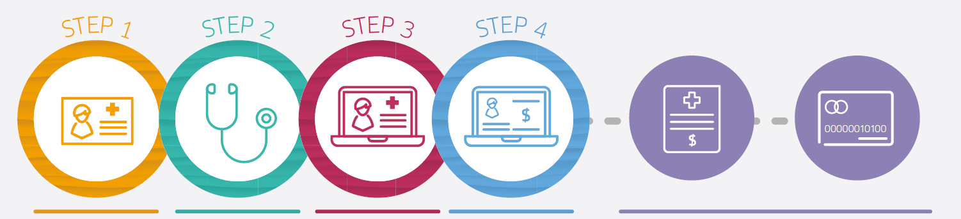

Health Savings Account (HSA) Overview
Using HSA Card for Medical Services
Present your Meritain ID card. | Complete visit. | Provider will submit claim to Meritain for processing visit. | Meritain adjusts claim & generates EOB (Explanation of Benefits) |  | You will receive an EOB & an invoice from provider. | Pay the patient responsibility from your HSA account.
Reminders:
Only available for the Aetna Open Access HSA.
If you enroll in the Open Access HSA plan Allied Beverage will contribute $600 if you are single, and $1,200 for Employee & Spouse, Employee & Child(ren), or Family into a Health Savings Account.
Assists with out-of-pocket medical, dental, vision, and prescription drug expenses.
You can contribute up to $4,300 Single / $8,550 if enrolled with dependents for 2025. You can contribute up to $4,400 Single and $8,750 if enrolled with dependents for 2026.
Notes:
Catch up contribution beginning at age 55 of +1,000 a year
Portable
Rollover
Enhanced retirement benefit.

Slide 9
Employee Contributions – Medical & Rx
COVERAGE LEVEL _{Bi-Weekly} (Non-Tobacco User) |  | Monthly
Open Access HSA
Employee Only | $62.85 | $136.18
Employee & Spouse | $157.14 | $340.46
Employee & Child(ren) | $106.85 | $231.51
Family | $188.56 | $408.55
Open Access EPO
Employee Only | $130.37 | $282.47
Employee & Spouse | $318.44 | $689.95
Employee & Child(ren) | $229.28 | $496.77
Family | $427.08 | $925.34
Open Access POS
Employee Only | $250.97 | $543.76
Employee & Spouse | $610.30 | $1,322.32
Employee & Child(ren) | $426.64 | $924.38
Family | $752.90 | $1,631.28
COVERAGE LEVEL _{Bi-Weekly} (Tobacco User) |  | Monthly
Open Access HSA
Employee Only | $97.47 | $211.18
Employee & Spouse | $191.75 | $415.46
Employee & Child(ren) | $141.47 | $306.51
Family | $250.16 | $542.02
Open Access EPO
Employee Only | $164.99 | $357.47
Employee & Spouse | $353.05 | $764.95
Employee & Child(ren) | $263.89 | $571.77
Family | $461.70 | $1,00.34
Open Access POS
Employee Only | $285.58 | $618.76
Employee & Spouse | $644.92 | $1,397.32
Employee & Child(ren) | $461.25 | $999.38
Family | $787.51 | $1,706.28
Bi-Weekly
Bi-Weekly
Notes:
Decreasing by up to 11%

Slide 10
Meritain – Additional Resources
Find a Provider
CVS MinuteClinic
Teladoc

Slide 11
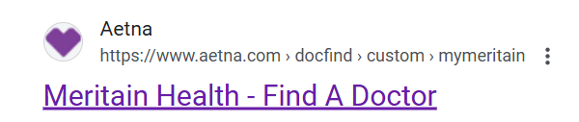
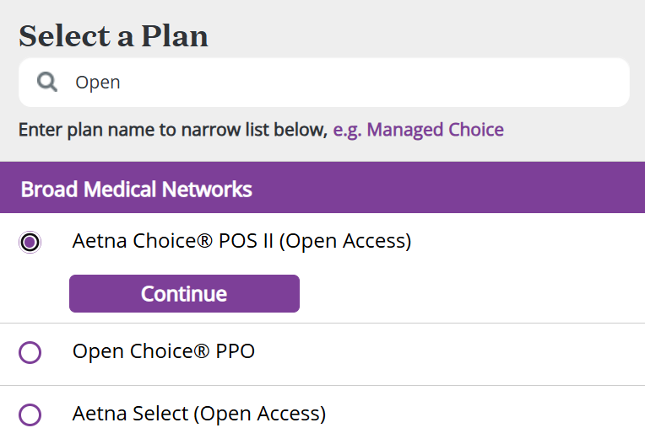
Finding an In-Network Provider - Medical
As a reminder, the provider network will remain the same this year despite the move to Meritain.
To access the provider list for the Meritain network before receiving your Member ID card, search Meritain DocFind Tool or navigate to https://www.meritain.com/resources-for-members-meritain-health-insurance/#ghi and scroll down to select Aetna under “Provider Network Finder”
Step 1 – In the search box, enter your location and set your search radius.
Step 2 – Under “Select a Plan,” scroll down to or search for the Aetna Choice POS II (Open Access) network. Select this network and click “Continue”
Step 3 - Locate providers by name, specialty, etc. or scroll down to find what you need by category

Slide 12
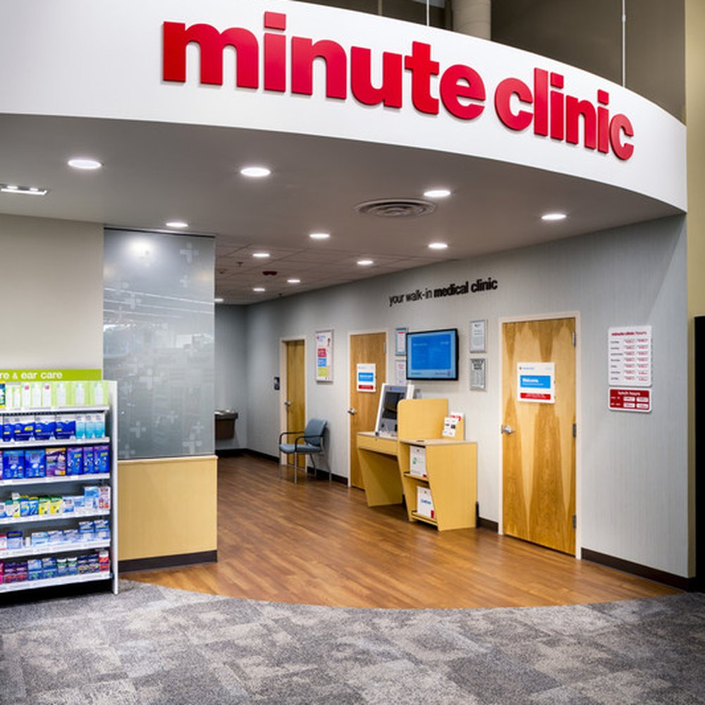
CVS MinuteClinic
CVS MinuteClinic is a walk-in clinic inside select CVS Pharmacy and Target stores, and is the largest provider of retail health care in the United States - with over 1,100 locations.
MinuteClinic is open every day, including evenings.
MinuteClinic offers walk-in and scheduled appointments.
Meritain members have access to all MinuteClinic services at NO COST
MinuteClinic physicians can diagnose and treat minor illnesses, injuries, and conditions, as well as write prescriptions
Notes:
This was available last year with Aetna and will continue to be available this year with Meritain.

Slide 13

Teladoc
ABG provides telemedicine services through Teladoc to all employees enrolled in any of the three medical plans. Teladoc offers 24/7/365 Access to Doctors. You can connect over the phone, or through live video chat and Teladoc doctors can diagnose and prescribe medication if needed
When to use it?
Allergies
Fever
Pink Eye
Rashes
Cold and Flu
Sore Throat
Behavioral Health
Earaches
Visit www.teladoc.com to connect with doctors over the internet, Call 1-800-TELADOC (835-2362), or download the mobile app.

Slide 14
Understanding SmithRx
SmithRx Overview
SmithRx Member Portal and Support
SmithRx Pharmacy Network

Slide 15
SmithRx
SmithRx is ABG’s new Pharmacy Benefit Manager (PBM). SmithRx manages the formulary of drugs covered under the plan and administers a number of programs designed to save you money. SmithRx is integrated directly with your Meritain Medical Plans and will be included on your ID card.
SmithRx Connect Programs
Assist Program The SmithRx Assist Program automatically finds you the lowest prescription cost at the point of sale, considering your pharmacy benefits and out-of-pocket expenses, resulting in a lower copay when you present your Meritain medical ID card at the pharmacy.
Mail Order Taking a maintenance medication and want it delivered straight to your door? Members have several options for mail order prescriptions including Walmart, Mark Cuban Cost Plus, and Amazon pharmacies.
Connect Program The SmithRx Connect program helps members taking high-cost or specialty medications find lower-cost alternatives, such as Manufacturer's Assistance Programs and International Sourcing, which can result in little to no copayment for their prescriptions.
Copay Maximization Program SmithRx will reach out to you if you qualify for a copay program through the prescription manufacturer. The cost of the medications through this program will never exceed your existing plan copay. In fact, you will often pay less. Depending on your medication, you may pay nothing at all.
www.smithrx.com | help@smithrx.com | 844-545-5201
Notes:
FAQ Talking Points. Step therapy, Exclusion of high cost brand drugs with clinically equivalent alternatives, Exclusion of high cost generics drugs with clinically equivalent , Up tiering of generic medications to non-preferred tier with lower cost alternatives, Exclusion of Branded products with direct generic alternatives, Opioid refill/days’ supply/morphine equivalent/long acting opioid restrictions.

Slide 16
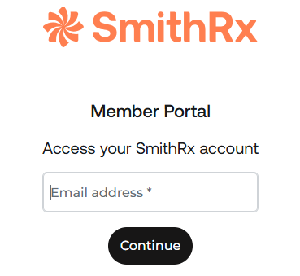
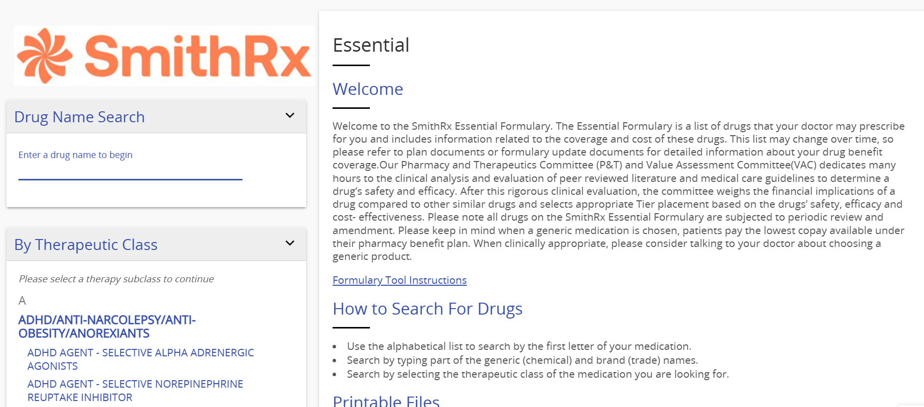
SmithRx Member Portal and Support
SmithRx Essential Formulary
www.smithrx.com | help@smithrx.com | 844-545-5201

Slide 17
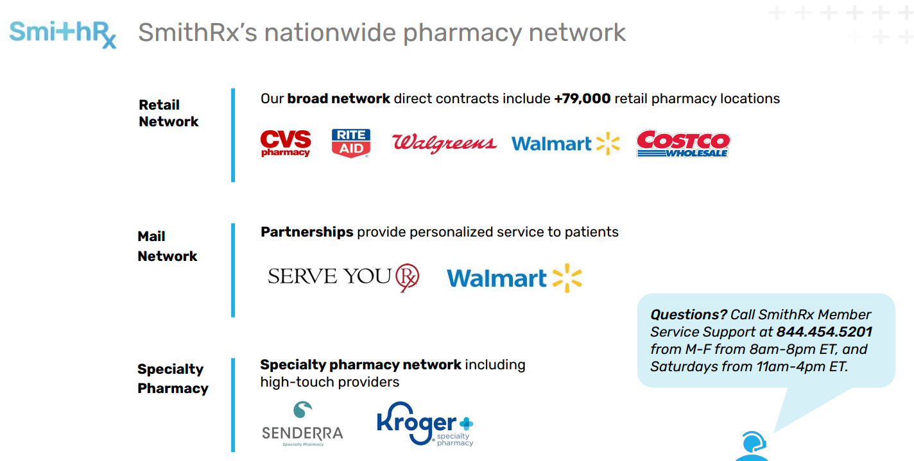


SmithRx Pharmacy Network
Members need to work with SmithRx or their provider to have current mail order or specialty medications transitioned to SmithRx specialty pharmacy.
Notes:
Specialty is mail order. Cannot go into actual Costco store. Membership not needed

Slide 18
Additional Benefits and Resources
Dental
Find a Provider
Vision
Preferred Network
Flexible Spending Accounts
Life and Disability
Voluntary Benefits
Questis
Employee Assistance Program (EAP)
ABG Perks
401(k)

Slide 19

Aetna Dental
All four plan designs will remain the same and will continue to be administered through Aetna. Each plan covers 2 Oral Exams/Cleanings per year.
BENEFIT OVERVIEW (In-Network) | DHMO | PPO Premier I | PPO Premier II | PPO Premier III
Annual Deductible (Individual/Family) | N/A | $50/$150 | $50/$150 | $50/$150
Annual Maximum paid by Aetna | N/A | $1,500 | $1,500 | $1,500
COVERED SERVICES
Preventative | 100% No Deductible | 100% No Deductible | 100% No Deductible | 80% No Deductible
Basic Services | Fee Schedule | 100% | 80% | 80%
Major Services | Fee Schedule | 50% | 50% | 50%
Orthodontic Benefits | Fee Schedule | Not Covered | 50% | Not Covered
Plan Lifetime Orthodontic Maximum (Adults & Children) | N/A | N/A | $1500 | N/A
Implants | Fee Schedule | N/A | N/A | 50%
Implants Maximum | N/A | N/A | N/A | $1500
*If you choose a dentist out of network there is a chance you will be billed for the remaining balance
Notes:
For the PPO plans, you can gain care OON You may pay more when you get care from dentists who aren’t in the network but You may pay more and have to file your own claims.

Slide 20
Finding an In-Network Provider - Dental
To access the provider list for the Aetna network prior to receiving your Member ID card go to www.Aetna.com then:
Step 1 – In the search box, enter “Find a Doctor”, then “Find a Doctor, Dentist or Hospital”
Step 2 – Under the Guest section, select “Plans from an Employer” & enter your home zip code
Step 3 - Adjust the number of miles you are willing to travel
Step 4 - Click “Search”
Step 5 - Scroll down to “Dental Plans” and select PPO/PDN with PPO II and Extend – for DENTAL
Step 6 - Click “Continue”
Locate providers by name, specialty, facility, etc. Narrow your selection to view a customized and detailed list of providers.

Slide 21
Aetna Vision Preferred
The vision plan will continue to be administered through Aetna. The plan design and employee contributions will remain the same.
BENEFIT OVERVIEW |  |  | PARTICIPATING PROVIDERS | NON-PARTICIPATING PROVIDERS
VISION EXAM (every 12 months) |  |  | $10 Copay | Up to $32 reimbursement
Standard Contact Lens Fit/Follow Up |  |  | Discounted fee off $40 | Not Covered
FRAMES (every 24 months) |  |  | $0 copay; $130 Allowance, 20% off balance over allowance | Up to $90 reimbursement
LENSES (every 12 months) |  | Single | $25 copay | $10 reimbursement
Lined Bifocal |  |  | $25 copay | $25 reimbursement
Lined Trifocal |  |  | $25 copay | $55 reimbursement
LENSE ENHANCEMENTS | Standard Progressive |  | $90 copay | $55 reimbursement
Premium Progressive Tier 1 |  |  | $110 copay | $25 reimbursement
Premium Progressive Tier 2 |  |  | $120 copay | $25 reimbursement
Premium Progressive Tier 3 |  |  | $135 copay | $25 reimbursement
Premium Progressive Tier 4 |  |  | $90 copay; 80% of charge less $120 allowance | $25 reimbursement
CONTACTS In lieu of glasses (every 12 months) |  |  | $130 Allowance (Maximum Copay of $60) | Up to $105 reimbursement
MEDICALLY NECESSARY CONTACTS |  |  | Covered 100% | Up to $200 reimbursement
Notes:
No ID card

Slide 22

Aetna Vision Preferred
The Aetna VisionSM Preferred Plan Features:
Convenient walk-in, night and weekend appointment availability
Discounts beyond plan benefits
Online appointment scheduling
Live support available 7 days a week (our customer service hours align with our retailer hours)
Over 110,000 local, independent providers
And online providers, too
Glasses.com
LensCrafters.com
TargetOptical.com
ContactsDirect.com
Ray-Ban.com
CVS Optical.com
Befitting.com
Popular retailers
Go to AetnaVision.com to find a provider near you. Your Aetna plan utilizes the EyeMed network.

Slide 23
Flexible Spending Accounts
2025 Flexible Spending Account Maximums
Medical Flexible Spending Account
$3,300
Dependent Care Flexible Spending Account
$5,000 Individual $2,500 if married and filing separate tax returns
Parking & Commuter Transit
$325/month
Sentinel Benefits will continue to administer all FSA accounts for the 2025-2026 Plan year. Flexible Spending Account are on Calendar year basis. So, your current plan will run from 1/1/2025 – 12/31/2025. Enrollment for 1/1/2026 – 12/31/2026 will occur at the end of this year.
Notes:
Flexible Spending Account are on Calendar year basis. So your plan will run from 1/1/2023 – 12/31/2023. Enrollment will occur at the end of this year.

Slide 24
Savings and Spending Accounts
ACCOUNTS AT A GLANCE | HEALTH SAVINGS ACCOUNT (HSA) | HEALTH FLEXIBLE SPENDING ACCOUNT (FSA) | DEPENDENT CARE FSA | TRANSIT AND PARKING
Description | Tax-advantaged savings account (the employer and employee can both contribute funds). | Tax-advantaged spending account (at Allied Beverage), only employees can contribute funds. | Tax advantaged spending account let’s employees use tax exempt funds to pay for childcare expenses they incur while at work. | Tax advantaged spending account used to pay for parking as part of your daily commute to work.
Pre-tax dollars? | Yes | Yes | Yes | Yes
What medical plan should I enroll in to be eligible for each account? | HSA Plan | EPO Plan PPO Plan | EPO Plan PPO Plan HSA Plan | EPO Plan PPO Plan HAS Plan
Is there an annual contribution limit? Please note, these limits are for 2025 | $4,300 for individual /$8,550 for coverage other than individual Catch-up contributions: $1,000/year (HSA owners 55 and older) | Yes, $3,300 annually. | $5,000 for individual $2,500 if married and filing separate tax returns | Yes, $325/month
When can I enroll? | You can make your HSA election during May 27 – June 13 when you enroll in the Open Access HSA plan. | A separate open enrollment period will be announced later for an effective date of 1/1/2026. | A separate open enrollment period will be announced later for an effective date of 1/1/2026. | If you are interested in enrolling in the commuter FSA, please contact Human Resources for an expedited enrollment

Slide 25

Basic Life Insurance and AD&D
Allied Beverage provides Basic Life and AD&D insurance benefits at no cost to you.
Enrollment is automatic and you will need to designate at least one primary and at least one contingent beneficiary.
BENEFIT AMOUNT
LIFE 1x Salary to Max of $100,000 (Age Reductions Apply) AD&D Maximum: Same amounts as above Minimum: $10,000 benefit for all classes

Slide 26
Voluntary (Supplemental) Life and AD&D
BENEFIT AMOUNT
Benefits - Employee Life Increments, $25,000 to max of $500,000 or 5x Earnings Guaranteed Issue: $200,000 (Age Reductions Apply) Benefits - Spouse Life* Increments, $5,000 -$50,000 to max of $50,000 or 50% of Employee Election Guaranteed Issue: $25,000 (Age Reductions Apply) Benefits - Child Life* Increments, $2,000 -$10,000 Birth to Age 26 *Spouses and children may only elect coverage if the employee has elected coverage. Please note, for this Open Enrollment only, The Hartford will not require Evidence of Insurability for Voluntary Life amounts elected up to the Guaranteed Issue amount. After this Open Enrollment, The Hartford Evidence of Insurability form is required when enrolling in coverage above the Guaranteed Issue or increasing your coverage amount after this enrollment period.

Slide 27
Disability Benefits
 | New Jersey State Temporary Disability Benefit | BASE LONG-TERM DISABILITY | BUY-UP LONG-TERM DISABILITY*
ELIGIBILITY | All Employees Working in NJ | All Full Time Non-Union Employees | All Full Time Non-Union Employees
EMPLOYEE CONTRIBUTION REQUIRED | Yes – Employee Contribution Required in NJ | No – Employer Paid | Yes – Employee Paid
ELIMINATION PERIOD | 7 Days | 180 Days | 180 Days
BENEFIT DURATION | 26-week max benefit | Social Security Normal Retirement Age | Social Security Normal Retirement Age**
BENEFIT AMOUNT | $1,055 Per Week | 50% of salary up to a max of $3,500 a month | 60% of salary up to a maximum of $10,000 a month
Please note, for this open enrollment, Evidence of Insurability is NOT required in order to elect the Buy Up Long-Term Disability benefit. If you decline during this Open Enrollment, Evidence of Insurability (EOI) will be required should you choose to enroll moving forward.
24 Month Own Occupation** | Pre-Existing Condition limitation 3/12** | Post Tax Payroll Deductions

Slide 28
Aetna Accident Insurance
Benefits for:
Initial care treatment
Ambulance
X-rays & medical imaging
Follow-up care treatment
Therapy services
Traumatic brain injury
Fractures & dislocations
Inpatient hospital treatment
Surgical care
Burns
Lodging and transportation
$50 health screening benefit*
How it works
The Aetna Accident Plan is designed to help cover out-of-pocket costs related to an accident.
Members receive cash benefits for a variety of accidental injuries and treatment as specified in the benefit summary.
…and more! See the plan summary for a full list of benefits and details.
Coverage Level | Bi-Weekly Cost | Monthly Cost
Employee Only | $4.28 | $9.28
Employee + Spouse | $6.85 | $14.85
Employee + Child(ren) | $8.08 | $17.50
Employee + Family | $12.75 | $27.63
*This benefit pays once per member per plan year for covered preventive tests (maximum of 1 test per plan year)
Notes:
Employees have a choice between XX plan options.

Slide 29
Aetna Hospital Indemnity Insurance
Benefits for:
Initial admission into the hospital
Daily inpatient hospital stays
Daily inpatient stays in rehabilitation, substance abuse, & mental disorder facilities
Routine newborn care
Observation room (one day per plan year)
How it works
The Aetna Hospital Indemnity Plan is designed to help cover out-of-pocket costs related to a planned or unplanned hospitalization.
Members receive cash benefits for a covered hospitalization, according to the benefit summary.
…and more! See the benefit summary included in your enrollment materials for a full list of benefits and details.
Coverage Level | Bi-Weekly Cost | Monthly Cost
Employee Only | $4.41 | $9.56
Employee + Spouse | $7.48 | $16.21
Employee + Child(ren) | $6.06 | $13.13
Employee + Family | $10.92 | $23.66
Notes:
$1,000 – no maximum stays per plan year, so long as admissions are separated by 30 days in a row. $50 per day thereafter, up to 365 days per year

Slide 30
Aetna Critical Illness Insurance
How it works
Benefits for:
Heart attack
Stroke
Invasive cancer
Organ failure
Loss of speech, sight or hearing
Coma
Non-invasive cancer & skin cancer
Coronary by-pass
Lupus
Parkinson’s disease
Alzheimer’s disease
Multiple sclerosis
$50 health screening benefit
Recurrence diagnosis (same illness)**
The Aetna Critical Illness Plan is designed to help cover out-of-pocket costs related to the diagnosis of a covered serious illness.
Members receive a lump sum cash benefit upon diagnosis, as specified in their benefit summary.
…and more! See the plan summary for a full list of benefits and details.
Rates are based on the employee’s age, coverage level and tobacco status. Employees may elect coverage in the amount of $10,000, $20,000, or $30,000. If employees elect coverage for themselves, they may elect up to 50% of their elected face amount for their spouse. Children are automatically enrolled at 25% of the employee’s elected benefit amount.
*Some infectious diseases [including coronavirus,] require a hospital stay of at least five days for benefits to be paid.
*[Recurrence illness diagnosis must occur at least 180 days after the initial diagnosis. Recurrence of cancer must be at least
Notes:
.

Slide 31


Voluntary Benefits – Legal Insurance
You will continue to have the option to enroll voluntary legal insurance through ARAG Legal.
Arag Legal provides affordable and convenient legal services and representation for a wide range of matters such as real estate matters, traffic matters, family law, tax issues, consumer protection disputes, and more!
*Contributions are made post-tax.
Call 1-800-247-4184 or visit www.araglegal.com to get started.
$9.57 Bi-Weekly | $20.75 Monthly

Slide 32


Voluntary Benefits – Pet Insurance
Allied Beverage Group is pleased to continue to offer a voluntary pet insurance through Nationwide. Nationwide pet insurance helps you cover veterinary expenses so you can provide your pets with the best care possible without worrying about the cost.
Nationwide offers a choice of reimbursement options so you can find coverage that fits your budget. All plans have a $250 annual deductible and $7,500 maximum annual benefit.
Coverage includes; Accidents, Illnesses, Hereditary and congenital conditions, Cancer, Dental diseases, Behavioral treatments, Rx therapeutic diets and supplements, and More!
Call 877-738-7874 or visit www.petinsurance.com/alliedbeverage to get started.

Slide 33
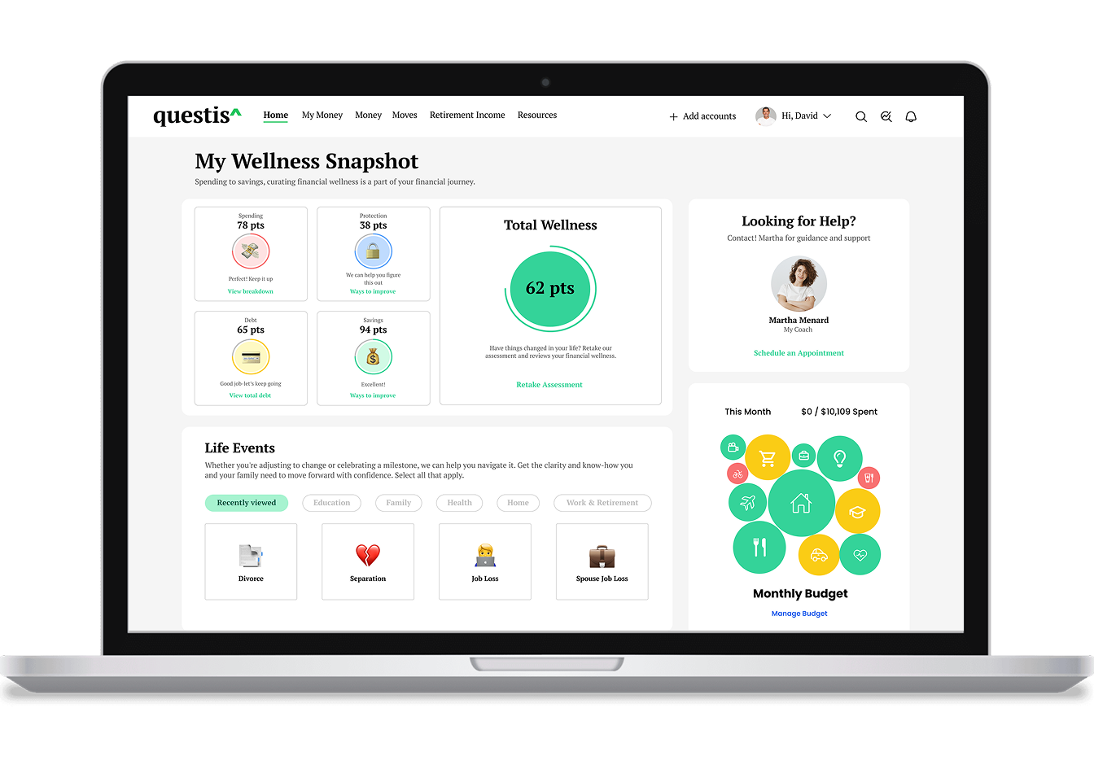
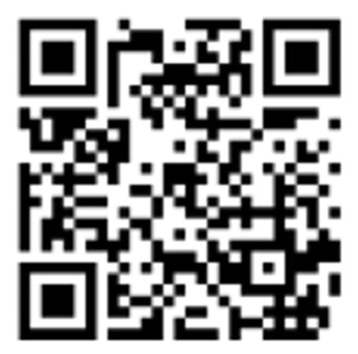
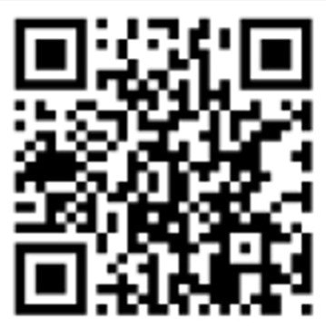
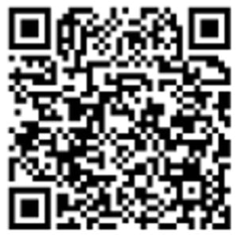

Questis
Meet Questis. Your Money. Your Goals. Your Path to Financial Wellness.
How Questis Can Help:
1-on-1 Financial Coaching – Talk to a real expert, anytime, about any financial topic.
Centralize Finances – Connect your bank accounts and get a one-screen view of your entire financial picture.
Smart Tools & Resources – Budgeting help, debt payoff strategies, and financial education at your fingertips.
Completely Confidential & Judgement-Free – Questis coaches will never sell you anything, just give you real support.
(845)-684-2888
support@myquestis.com
Meet Your Coach
Get Started
Need Login Help?

Slide 34



Employee Assistance Program (EAP)
All ABG employees and dependents can take advantage of up to 5 FREE mental health counseling sessions per issue, unlimited in the moment counseling, and unlimited work-life referral services through the confidential Carebridge EAP.
Employee Assistance Program
CarebridgeNow.com
Access Code: BAZDV
800.437.0911

Slide 35
Retirement Plan – 401(k)
Your 401(k) plan will be administered by Sentinel Benefits. There are no changes to this program.
All Non-Union Eligible Employees over the age of 18 are eligible for the 401(k) plan on the first of the month following 90 days of employment. All Merchandisers are eligible 1st day of the quarter following 12 months of employment.
If you would like to learn more about your 401(K) plan, please contact your Human Resources department.

Slide 36

Medicare Resource
Allied Beverage Group has partnered with Malloy Advisors to offer Medicare advising, at no cost to you! Mallory Advisors help you understand Medicare and guide you through the process.
Malloy Advisor highlights:
No cost to you, no obligation
Provide help answering anything related to Medicare enrollment
Provide clarity and reduce anxiety during a confusing process
Trusted resource to individuals nationwide
Access to personalized Medicare guidance for each individual
Access to Medicare 101 educational seminars online and in-person
Dial: 800-933-8129 | Email: answers@malloymedicare.com
Website: www.malloymedicare.com

Slide 37
Employee Perks
As an Allied Beverage Group employee, you have access to countless employee perks. Please refer to your employee benefits guide for more detail and if you have any questions, please reach out to your HR department.
Cheers! Recognition Program | Affinity Credit Union ($5.00 to enroll) | The Lightbridge Academy Circle of Care
New Jersey Manufacturers Insurance Company | Associate Referral Award Program | ADP LifeMart
Anniversary & Retirement Program | Plum Benefits | Dell Discount Program
Verizon Wireless Discounts | Scholarship Programs | Commute on Us Program
Ruby Tuesday's Associate Discount | Marriott Hotel & Bistro Discount

Slide 38

Customer Service Support
The Graham Company provides an Employee Benefits Concierge Line to assist Allied Beverage employees with questions related to:
Claim Payments
Coverage Explanations
Eligibility
Any other issue or question you cannot resolve when you contact the insurance company directly
The Employee Benefits Concierge Line is staffed Monday through Friday, 9:00 AM to 5:00 PM EST.
Toll Free 1-888-842-1488
Graham-Benefits@MarshMMA.com

Slide 39
Thank you! Are there any questions?

