Slide 1

Plan Year:
8/1/25 – 7/31/26
Enroll:
6/23/25 – 7/6/25
OPEN ENROLLMENT 2025

Slide 2
What is Open Enrollment?
Make changes to benefits
Once enrolled, you will not be able to make changes or cancel coverage until the next Annual Open Enrollment period, unless you experience a qualified life event!
Add or remove dependent(s)
Qualified Life events
  Marriage
  Birth, adoption
  Change in job status
  Change in Medicare status
Enroll in coverage for the first time
All enrollments must be completed by July 6, 2025.
Waive previously elected coverage

Slide 3
Overview
Part One
Part Two
Key Points
Medical, Dental, & Vision Plan Designs
Payroll Deductions
Voluntary Benefits
How to Enroll
Graham Company Service Line
UHC Medical, Dental, & Vision
  Find a Provider
  ID Card and Network Information
  Additional UHC Programs
The Hartford Voluntary Benefits
  Claims Process

Slide 4
Part One
An overview of your 2025 benefit offerings.

Slide 5
Glossary
ALLOWABLE CHARGE is the dollar amount typically considered payment in full by an insurance company and an associated network of health care providers.
COINSURANCE is the amount you pay, as a percentage of the allowed cost of your services, after you reach the deductible and until you reach the plan’s out-of-pocket maximum.
COPAYMENT (COPAY) is a fixed amount you pay for a health care service or prescription drug.
DEDUCTIBLE is the amount you pay before your insurance begins covering certain services, such as hospitalization or outpatient surgery. The deductible resets on a calendar year basis (every January 1st).
DRUG FORMULARY is a list of prescription drugs, maintained by medical professionals, that practitioners use to identify drugs that offer the greatest overall value.
IN-NETWORK PROVIDERS are providers and facilities that are contracted with UHC to provide healthcare. You can reduce your cost by utilizing the in-network providers.
OUT-OF-NETWORK PROVIDERS are providers and facilities that do not contract with UHC to provide healthcare. You may be subject to balance billing. This is when the provider charges you for the difference between what UHC has paid, and the actual charge. In addition, you will be subject higher out of pocket expenses (deductibles and coinsurance).
OUT-OF-POCKET MAXIMUM is the most you pay per plan year for health care expenses, including prescription drugs. Once you reach this limit, the plan pays 100% of the cost of services for the remainder of the plan year. The out-of-pocket maximum resets on a calendar year basis (every January 1st).
PREMIUM is the amount you pay for insurance, using pre-tax dollars via paycheck deductions. (Note: Araca pays a portion of the premium.)
*NOTE Preventive wellness exams are covered once every 12 months for medical and vision, and once every 6 months for dental. For example, someone who had an annual medical physical August 1, 2024 would need to wait until after August 1, 2025 to schedule their next physical.
Notes:
Deductibles and Out-of-Pocket maximums reset on a calendar year basis, or every January 1st. We have added this to the glossary.

Slide 6
Key Points
There will be no changes to the UHC Base and Buy Up Medical Plans.
There is a slight increase to contributions for both Medical Plans.
There will be no changes in the UHC Dental plan designs or cost.
There will be no changes in the UHC Voluntary Vision plan design or cost.
Araca will continue to offer voluntary benefits from The Hartford. Costs for these plans will remain the same.
You will enroll for benefits in Employee Navigator.
Notes:
Base Plan members will not receive new ID cards since there are no plan changes.
Buy Up and Executive Plan members will receive new ID cards. They will be electronic ID cards as long as members opted “yes” to electronic communications. Members will receive email notice from UHC once their digital ID card is available. We have noted this on slide 26.

Slide 7

Medical: Base Plan
 | In Network | Out of Network
Medical Deductible (single / family) | $5,000 / $10,000 | N/A
Benefit Level (% covered by insurance) | 80% | N/A
Out-of-Pocket Max (single / family) | $8,150 / $16,300 | N/A
OFFICE VISITS
Primary Doctor Visit | $0 copay | Not Covered
Specialist Visit | $100 copay | Not Covered
Preventive Care | 100% | Not Covered
Virtual Visits | $0 copay | Not Covered
HOSPITAL CARE
Inpatient Hospital Care | 80%, after deductible | Not Covered
Outpatient Surgery | 80%, after deductible | Not Covered
Emergency Room | $250 Copay and 80% after deductible | Not Covered*
OTHER SERVICES
X-Ray & Lab | 80%, after deductible | Not Covered
Major Radiology (CAT, MRI, PET, etc.) | 80%, after deductible | Not Covered
Outpatient Therapy (Occ., Speech, PT) | 80%, after deductible | Not Covered
Urgent Care | $50 copay | Not Covered
PRESCRIPTION DRUG
Rx Deductible (single / family) | $100 Single / $300 family | N/A
Retail (30-day supply)
Generic | $15 copay, after deductible | Not Covered
Formulary | $35 copay, after deductible | Not Covered
Non-Formulary | $75 copay, after deductible | Not Covered
Mail Order (90-day supply) | Generic: $37.50 copay, after deductible Formulary: $87.50 copay, after deductible Non-Formulary $187.50 copay, after deductible | Not Covered
*If faced with an emergency and taken to an out of network facility, in-network emergency room coverage will apply
The above is a brief description of the most commonly used benefits. It does not include all benefits, maximums, and/or limitations. Please refer to the carrier plan documents for more detail. The insurance company and Certificate of Coverage/Plan Documents will provide the final determination of benefits. Any discrepancies, the carrier plan document prevails.

Slide 8
Medical: Buy-Up Plan
 | In Network | Out of Network
Medical Deductible (single / family) | $0 single / $0 family | $1,000 single / $2,000 family
Benefit Level (% covered by insurance) | 100% | 70%, after deductible
Out-of-Pocket Max (single / family) | $2,500 single / $5,000 family | $4,000 single / $8,000 family
OFFICE VISITS
Primary Doctor Visit | $40 copay | 70%, after deductible
Specialist Visit | $40 copay | 70%, after deductible
Preventive Care | 100% | 100%
Virtual Visits | $0 copay | Not Covered
HOSPITAL CARE
Inpatient Hospital Care | $300 copay per admission | 70%, after deductible
Outpatient Surgery | $250 copay | $250 copay, then 70% coinsurance
Emergency Room | $200 copay per visit | $200 copay per visit
OTHER SERVICES
X-Ray & Lab | 100% | 70%, after deductible
Major Radiology (CAT, MRI, PET, etc.) | 100% | 70%, after deductible
Outpatient Therapy (Occ., Speech, PT) | $40 copay | 70%, after deductible
Urgent Care | $75 copay | 70%, after deductible
PRESCRIPTION DRUG
Rx Deductible (single / family) | $100 single / $300 family
Retail (30-day supply)
Generic | $10 copay, after deductible | $10 copay, after deductible
Formulary | $30 copay, after deductible | $30 copay, after deductible
Non-Formulary | $50 copay, after deductible | $50 copay, after deductible
Mail Order (90-day supply) | Generic: $25 copay, after deductible Formulary: $75 copay, after deductible Non-Formulary $125 copay, after deductible | Not Covered
The above is a brief description of the most commonly used benefits. It does not include all benefits, maximums, and/or limitations. Please refer to the carrier plan documents for more detail. The insurance company and Certificate of Coverage/Plan Documents will provide the final determination of benefits. Any discrepancies, the carrier plan document prevails.
Notes:
Out of network deductible going to $1k / $2k (currently $900 / $1.8k)
Out of Pocket Maximum going down to $4k / $8k (currently $4.65k / $9.3k). This is a plan enhancement.
Outpatient surgery going to $250 copay (currently covered 100%)
Emergency Room copay going to $200 copay (currently $100 copay)
Urgent Care going to $75 copay (currently $50 copay)

Slide 9
Medical Payroll Deductions
Base Plan
Tier Level | Bi-Weekly Cost | Weekly Cost
Employee Only | $50.16 | $25.08
Employee + Spouse | $461.48 | $230.74
Employee + Child(ren) | $337.20 | $168.60
Family | $798.83 | $399.42
Buy-Up Plan
Tier Level | Bi-Weekly Cost | Weekly Cost
Employee Only | $350.52 | $175.26
Employee + Spouse | $1,048.76 | $524.38
Employee + Child(ren) | $826.58 | $413.29
Family | $1,651.77 | $825.89
Please Note: Araca will contribute 85% of the total cost of the Single Base Plan coverage, while employees contribute 15%, plus any additional premium costs for higher levels of coverage.

Slide 10
Dental
 | Base PPO |  | Buy Up PPO
Benefit Overview | In-Network | Out-of-Network | In-Network | Out-of-Network
Annual Deductible | $50 single / $150 family |  | $50 single / $150 family
Annual Maximum | $1,500 |  | $1,500
Covered Services | In-Network | Out-Of-Network | In-Network | Out-of-Network
Preventive | 100% | 100%* | 100% | 100%*
Basic | 80% | 80%* | 90% | 80%*
Major | 50% | 50%* | 60% | 50%*
The above is a brief description of the most commonly used benefits. It does not include all benefits, maximums, and/or limitations. Please refer to the carrier plan documents for more detail. The insurance company and Certificate of Coverage/Plan Documents will provide the final determination of benefits. Any discrepancies, the carrier plan document prevails.
*When utilizing out of network providers, UnitedHealthcare will only pay the coinsurance percentages shown up to the in network discounted rate (Allowable Charge). The employee is responsible for the difference. For example, if your provider charges you $300 but United Healthcare allows $200 – you will still be responsible for anything over the allowed amount even if this is not ‘member responsibility’ and you can be balance billed.

Slide 11
Dental Payroll Deductions
Base PPO
Tier Level | Bi-Weekly Cost | Weekly Cost
Employee Only | $0 | $0
Employee + 1 Dependent | $12.42 | $6.21
Family | $33.06 | $16.53
Buy Up PPO
Tier Level | Bi-Weekly Cost | Weekly Cost
Employee Only | $7.46 | $3.73
Employee + 1 Dependent | $27.13 | $13.56
Family | $59.14 | $29.57

Slide 12
Vision
UHC Vision | UHC Vision
Benefit Overview | Participating Providers | Non-Participating Providers
Vision Exam (every 12 months) | $10 copay | Up to $40 reimbursement
Materials | $25 copay | N/A
Frames (every 24 months) | $130 allowance 30% discount on balance with participating providers | Up to $45 reimbursement
Lenses (every 12 months)
Single | Covered 100% after materials copay | Up to $40 reimbursement
Lined Bifocal |  | Up to $60 reimbursement
Lined Trifocal |  | Up to $80 reimbursement
Lense Enhancements
Standard progressive | $55 | N/A
Premium Progressive | $100
Custom Progressive | $150 - $250
Contacts (in lieu of glasses – every 12 months) | Formulary: Up to 4 boxes Non-Formulary: Up to $105 | Up to $105 reimbursement
Medically Necessary Contacts | Covered 100% | Up to $210 reimbursement
The above is a brief description of the most commonly used benefits. It does not include all benefits, maximums, and/or limitations. Please refer to your plan documents for more detail. UHC and Certificate of Coverage/Plan Documents will provide the final determination of benefits. Any discrepancies, the UHC plan document prevails.

Slide 13
Vision Payroll Deductions
UHC Vision 100% Employee-Paid
Tier Level | Bi-Weekly Cost | Weekly Cost
Employee Only | $1.76 | $0.88
Employee + Spouse | $3.34 | $1.67
Employee + Child(ren) | $3.91 | $1.96
Family | $5.51 | $2.75

Slide 14

Voluntary Benefits
Accident Insurance
Hospital Indemnity (Medical Bridge)
Short-Term Disability
Provides payment for expenses not covered by medical insurance. Covers a wide range of treatments due to an accident and payment is sent directly to the member.
Can help cover unexpected out-of-pocket expenses (copays, deductibles, out-of-network charges), as well as everyday living expenses. It pays a benefit directly to you a lump-sum for hospital-related events, regardless of your treatment costs or other insurance coverage you might have.
If you become disabled from a non-work-related injury or sickness, disability income benefits will provide a partial replacement of lost income. Benefits are paid directly to the insured after they satisfy the elimination period. This coverage is only available for Araca employees (not dependents)and is not available for CA residents.
Notes:
Only pre-ex for std

Slide 15
Short Term Disability
Who is eligible? | Active full-time employees (not available for residents of CA)
When does coverage begin? | New employees: First of the month following 60 days of employment (60-day waiting period) Other employees: Policy effective date
Does my coverage have portability? | No. You are unable to continue this coverage upon the end of employment with Araca.
When am I entitled to receive benefits? | If, while covered under this benefit, You: 1) become disabled; 2) are under the regular care of a physician and remain disabled; and 3) submit proof of loss (documentation of disability/prognosis, medical information, physician contacts, etc.); The Hartford will pay the weekly benefit. The amount of any weekly benefit payable will be reduced by the total amount of all other income benefits provided.
What are the benefit amounts? | When electing coverage, employees will select coverage in increments of $100. The minimum election is $100, and the maximum is $2,000, but you may not elect more than 50% of your weekly earnings.

Slide 16
Short Term Disability Plan Cost
Short Term Disability plan costs vary depending on your age and the benefit amount selected. Please see below an example of what costs might look like for you:
Example: a 25-year-old Araca employee in New York elects Short Term Disability with a $200 per week benefit amount.
  Based on this information, this employee would pay about $9.67 per pay period for their Short-Term Disability Benefit.
Keep in mind, the higher the benefit amount, the greater the per pay period cost will be.
When electing coverage in Employee Navigator, you will be able to see your per pay period cost.

Slide 17
Accident Insurance
Who is eligible? | Active full-time employees Dependents of enrolled employees
When does coverage begin? | New employees: First of the month following 60 days of employment (60-day waiting period) Other employees: Policy effective date
Does my coverage have portability? | Yes - Must submit request for coverage continuation with the required premium within 31 days after the policy terminates.
What are the benefit amounts? | Accident Follow-Up Benefit - $100 Ambulance (Air) Benefit - $2,000 Ambulance (Ground) Benefit - $750 Blood/Plasma/Platelet Benefit - $300 Child Care Benefit - $35 per day Diagnostic Exam Benefit - $300 Chiropractic Care Benefit - $50 Emergency Room Benefit - $200 Hospital Admission Benefit - $1,500 | Physical Therapy Benefit - $75 per day Rehabilitation Facility Benefit - $300 per day Urgent Care Benefit - $150 X-Ray Benefit - $15 Abdominal/Thoracic Surgery Benefit - $2,599 Second Degree Burns - $1,500 Third Degree Burns - $15,000 Concussion Benefit - $200 Hernia Benefit - $400
What can I use the Benefit for? | The benefits received from this plan can be used to offset any out-of-pocket costs you may experience due to an accident, including helping to pay towards the cost of the deductible and coinsurance.

Slide 18
Accident Insurance Plan Cost
Accident Insurance 100% Employee-Paid
Tier Level | Bi-Weekly Cost | Weekly Cost
Employee Only | $4.63 | $2.32
Employee + Spouse | $7.29 | $3.64
Employee + Child(ren) | $7.81 | $3.90
Family | $12.26 | $6.13

Slide 19
Hospital Indemnity
Who is eligible? | Active full-time employees Dependents of enrolled employees
When does coverage begin? | New employees: First of the month following 60 days of employment (60-day waiting period) Other employees: Policy effective date
Does my coverage have portability? | Yes - Must submit request for coverage continuation with the required premium within 31 days after the policy terminates.
When am I entitled to receive benefits? | First Day Hospital Confinement: On the first day a covered person is confined to a hospital as an inpatient as the result of a covered illness or injury. Daily Hospital Confinement: Each day a covered person is confined to a hospital as an inpatient as the result of a covered illness or covered injury beyond the first day. Daily ICU Confinement: Each day a covered person is confined to an Intensive Care Unit (ICU) as the result of a covered illness or injury, beginning on the second day of Confinement.
What are the benefit amounts? | $1,000 on first day of hospital confinement, regardless of whether covered individual was admitted to ICU. $100 per day for any additional days of confinement (day 2 forward). $200 per day for any additional days of ICU confinement (day 2 forward). Please note: You cannot collect more than one benefit on a single day.
What can I use the Benefit for? | The benefits received from this plan can be used to offset any out-of-pocket costs you may experience due to being admitted to the hospital, including helping to pay towards the cost of the deductible and coinsurance.

Slide 20
Hospital Indemnity Plan Cost
Hospital Indemnity Insurance 100% Employee-Paid
Tier Level | Bi-Weekly Cost | Weekly Cost
Employee Only | $5.02 | $2.51
Employee + Spouse | $11.25 | $5.63
Employee + Child(ren) | $10.23 | $5.12
Family | $17.32 | $8.66

Slide 21

How to Enroll Using Employee Navigator
STEP 1 | Visit – https://www.employeenavigator.com/
STEP 2 | Click the green ‘Login’ button in the top right corner of the screen.
STEP 3 | On the next page click the ‘Register as a new user’ link.
STEP 4 | Enter the requested information on the next screen. First Name Last Name Company Identifier: ARACA Pin (Last four of social)
STEP 5 | Choose a username and password. If your email address is on file, it is pre-populated as a recommended username.
STEP 5 | Enroll in Benefits.
ENROLL ONLINE: Employee Navigator is set up to automatically take you through each of the following steps:
IMPORTANT: Benefit elections/declines cannot be changed for the entire 2024-2025 plan year outside of a qualifying event.

Slide 22

Graham Company Service Line
The Graham Company provides an Employee Benefits Service Line to assist Araca employees with inquiries related to:
Claim Payments
Coverage Explanations Eligibility
Any other issue or question you cannot resolve when you contact the insurance company directly.
The Employee Benefits Service Line is staffed Monday through Friday, 9:00 AM to 5:00 PM EST.
Toll Free 1-888-842-1488
BenefitsAssist@grahamco.com

Slide 23
Questions?
Part Two coming up next.

Slide 24
Part Two
Learn more about your benefits and how to use them.

Slide 25

UHC Telehealth
Sign in to your UHC Member Portal or utilize the UnitedHealthcare App for Virtual Visits.
Virtual Visits allow you to consult with a provider over the phone or via video chat to address your healthcare needs.
Use a Virtual Visit for these common conditions:
Allergies
Bronchitis
Flu
Eye infections
Headaches/Migraines
Sore Throats
Stomach Aches
Rashes
And More
Behavioral Health Virtual Health Visits are also available to members of the health plan. Behavioral Health Virtual Visits allow members to speak to a professional from the comfort of their home. The member cost share is the same as outpatient mental health per the member’s benefit design.

Slide 26
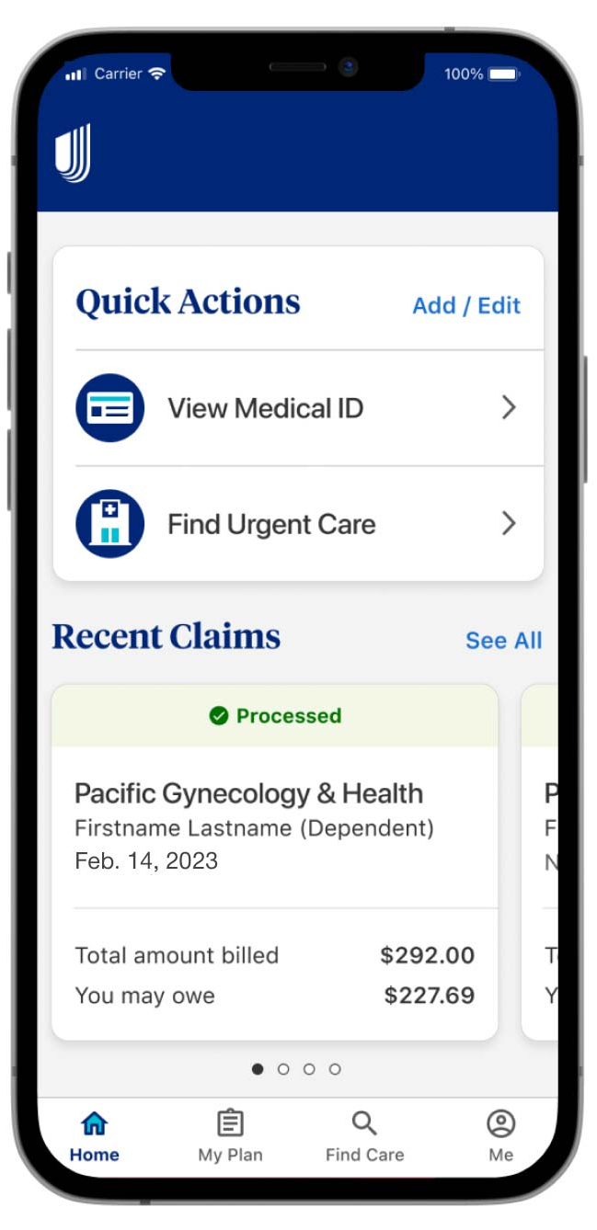
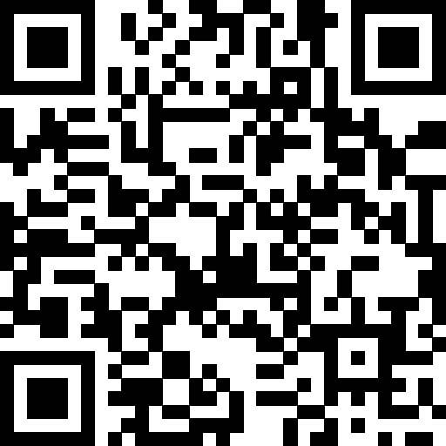
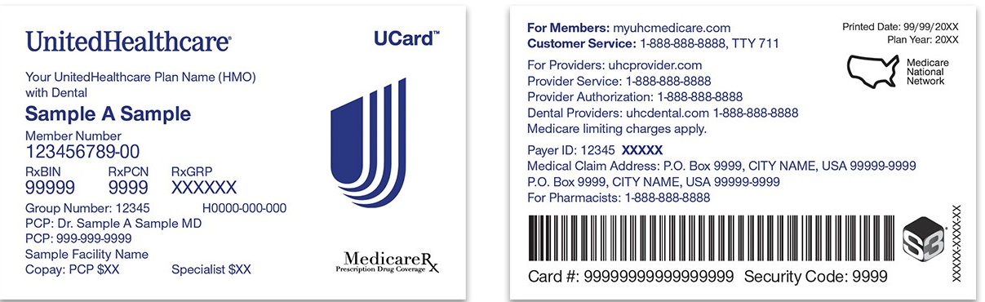
UHC ID Card
You can find your member ID number and a copy of your medical ID card on myuhc.com or the UnitedHealthcare App.
Please note, if you have opted in for electronic communications with UHC, you will not receive a new physical ID card. You will only receive a virtual ID card, which can be accessed via the UHC portal or app.
If you have family members enrolled in the plan, they will receive their own individual ID card and Member ID number.
You do not have Dental or Vision ID cards. To access the UHC dental and vision plans, you simply need to provide your name and social security number to your provider.
Scan to download the UnitedHealthcare App

Slide 27
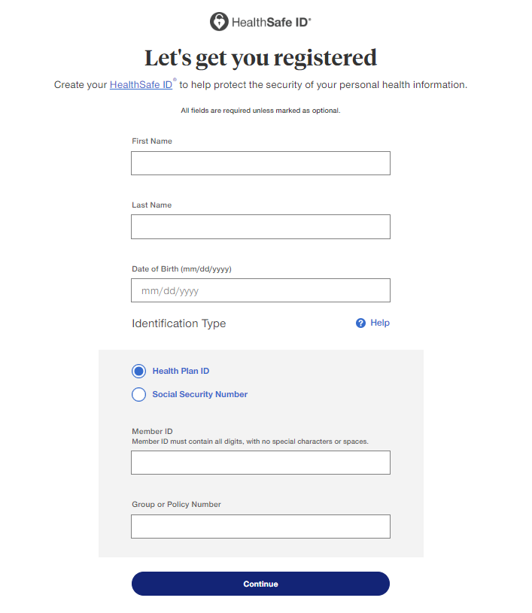
UHC Portal Access
For new employees or those newly enrolled in Medical, Dental, or Vision benefits, you will have to register for the UHC Member Portal.
Please navigate to member.uhc.com/myuhc and select ‘Register’
You will be prompted to enter your Name and Date of Birth before selecting an ‘Identification Type’
If you elected a UHC Medical Plan: Please select Health Plan ID and enter your Member ID and Group or Policy Number that can be found on your UHC ID Card.
If you elected a UHC Dental or Vision Plan: Please select Social Security Number and enter your SSN and ZIP Code to verify your identity.
Once verified, please continue setting up your account as prompted.

Slide 28

UHC Network Information
Medical
Base Plan - This plan utilizes the UHC Choice Network.
Buy Up Plan – This plan utilizes the UHC Choice Plus Network.
Dental
Base PPO – This plan utilizes the UHC PPO20 network.
Buy Up PPO – This plan utilizes the UHC PPO30 network.
Vision
Under your UHC Vision plan, you have access to providers in the UHC Vision Network.

Slide 29
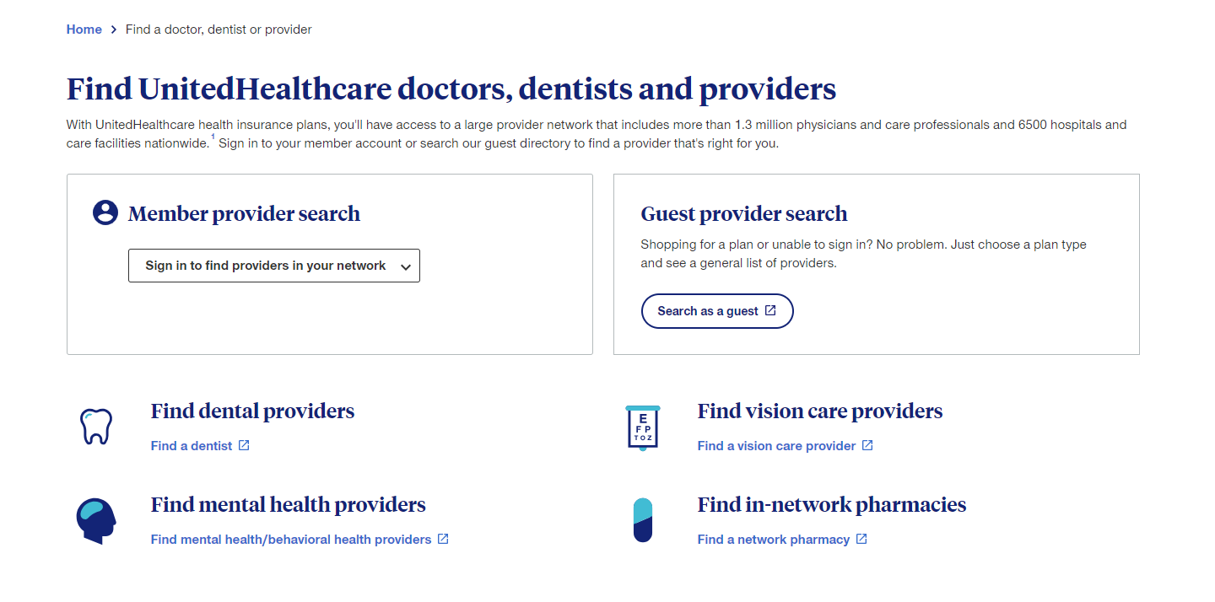
UHC Find a Provider
Before selecting a medical, dental, or vision provider, check that they are in your plan network.
Please remember that utilizing In-Network providers is generally more cost-effective than Out-of-Network providers.
You can call the service number on your member ID card or navigate to uhc.com/findaprovider to sign into your UnitedHealthcare account and search the provider directory.

Slide 30

UHC EAP
UHC’s Employee Assistance Program (EAP) provides 24/7 direct access to personalized support, resources and no-cost referrals to help you, and your family, with a range of issues, including:
Managing stress, anxiety and depression
Improving relationships at home or work
Getting guidance on legal and financial concerns
Coping with occupational stress and burnout support
Addressing substance use issues
Call EAP 24/7 at 1-888-887-4114 for access to master’s level EAP specialists at no additional cost.
The EAP provides coverage for 3 free counseling sessions per incident, per year. Services are completely confidential and will not be shared with your employer.

Slide 31
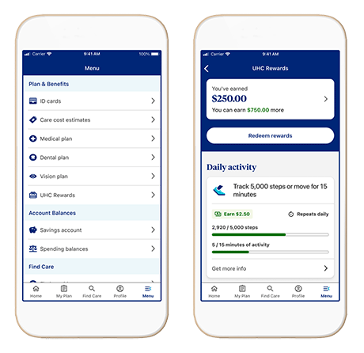
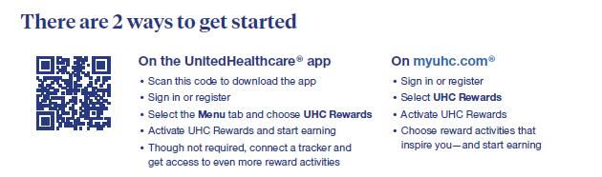
UHC Rewards
This program rewards members for taking healthy actions – all within the myuhc member portal and the UnitedHealthcare app. UHC Rewards is included in Araca’s medical plans at no additional cost.
Complete a variety of activities – including many things you may already be doing – to earn up to $300 in rewards. The activities you select are up to you, and the same goes for how you spend your rewards.
Here are some examples of reward-earning activities:
Reach Daily Goals
  Track 5,000 steps or 15 active minutes each day
    Double these numbers for an even greater reward
  Track 14 nights of sleep
Complete One-Time Rewards
  Opt to go paperless
  Get a biometric screening
  Take a health survey
  Connect a fitness tracker

Slide 32
UHC Additional Programs
Real Appeal Virtual Weight Loss Program
Virtual weight-loss program clinically proven to help members lose weight through lifestyle and behavioral modification. With the guidance of a transformation coach, participants learn how to incorporate small, simple changes into their everyday lives to achieve long-term, sustainable weight loss. To help with the weight loss journey, participants have year-round access to a suite of robust online tools and receive a Success Kit in the mail – all at no cost!
Quit For Life Tobacco Cessation Program
Clinically proven tobacco cessation program offered in collaboration with the American Cancer Society®. It combines digital and telephonic tools and resources, along with physical, psychological and behavioral strategies, to provide members with a personalized quit plan to overcome their tobacco addiction.
Cancer Support Program
No matter what type of cancer you or a family member have been diagnosed with, the UnitedHealthcare Cancer Resource Services provides access to top-performing cancer centers across the country.
Find information about these programs and more at uhc.com/member-resources/health-care-programs

Slide 33
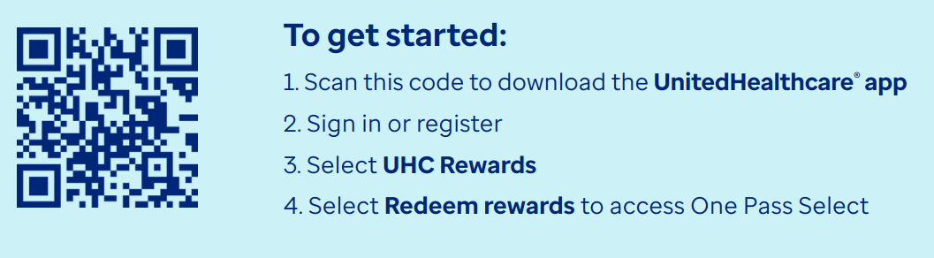
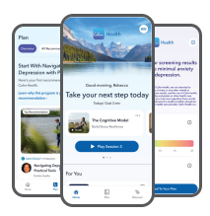

UHC Additional Programs
One Pass Select® can help you reach your fitness goals while finding new passions along the way. Find a routine that’s right for you whether you work out at home or at the gym. Choose a membership tier that fits your lifestyle and provides everything you need for whole body health in one easy, affordable plan.
You and your eligible family members (18+) can get started with when you activate UnitedHealthcare Rewards. Plus, you can use your earnings to help pay for your membership.
One Pass Select
The Calm Health app provides programs and tools to help support your mental health and well-being — all at your own pace. The app brings you a library of support, including mindfulness content and programs created by psychologists for a variety of health experiences and life stages. As a UnitedHealthcare member, Calm Health is included in your health plan and available at no additional cost.
Calm Health

Slide 34
File a Claim:
Accident & Hospital Indemnity
You must provide The Hartford with a written notice of a claim within 20 days after the start of any loss covered by the policy.
The three forms needed to file a claim are as follows:
Policyholder (Employer) Claim Form
Claimant (Employee) Statement
Attending Physician Statement Form
These forms can be obtained through your employer or through The Hartford Online Portal. You must also submit Proof of Loss (documentation of loss, medical information, physician contacts, etc.) within 120 of the date of the loss.
Online Portal: www.benefitsclaims.thehartford.com
The Hartford Claims Support: 866-547-4205
Policy Number: VAC898357

Slide 35
File a Claim: Short-Term Disability
You must provide The Hartford with a written notice of a claim within 30 days after the disability occurs. Once the claim is received, you will have to submit Proof of Loss within 90 days.
Step 1:
Step 2:
Step 3:
Know when it's time to take action.
If you’re absent from work, we can advise you on when to file a claim. If your absence is scheduled, such as an upcoming hospital stay, call us 30days prior to your last day of work. If unscheduled, please call us as soon as possible.
Have this information ready:
Name, address and other key identification information.
Name of your department and last full day of active work.
The nature of your claim.
Your treating physician’s name, address, phone and fax numbers.
Your Policy Number: 898357
Make the call or file online
With your information handy,
call The Hartford at 1-800-549-6514.
You’ll be assisted by a caring professional who’ll take your information, answer your questions, and file your claim.
File online at: www.thehartford.com/employee-benefits/claims

Slide 36
Questions?
Thank you!

Slide 37
Appendix
Additional Information

Slide 38
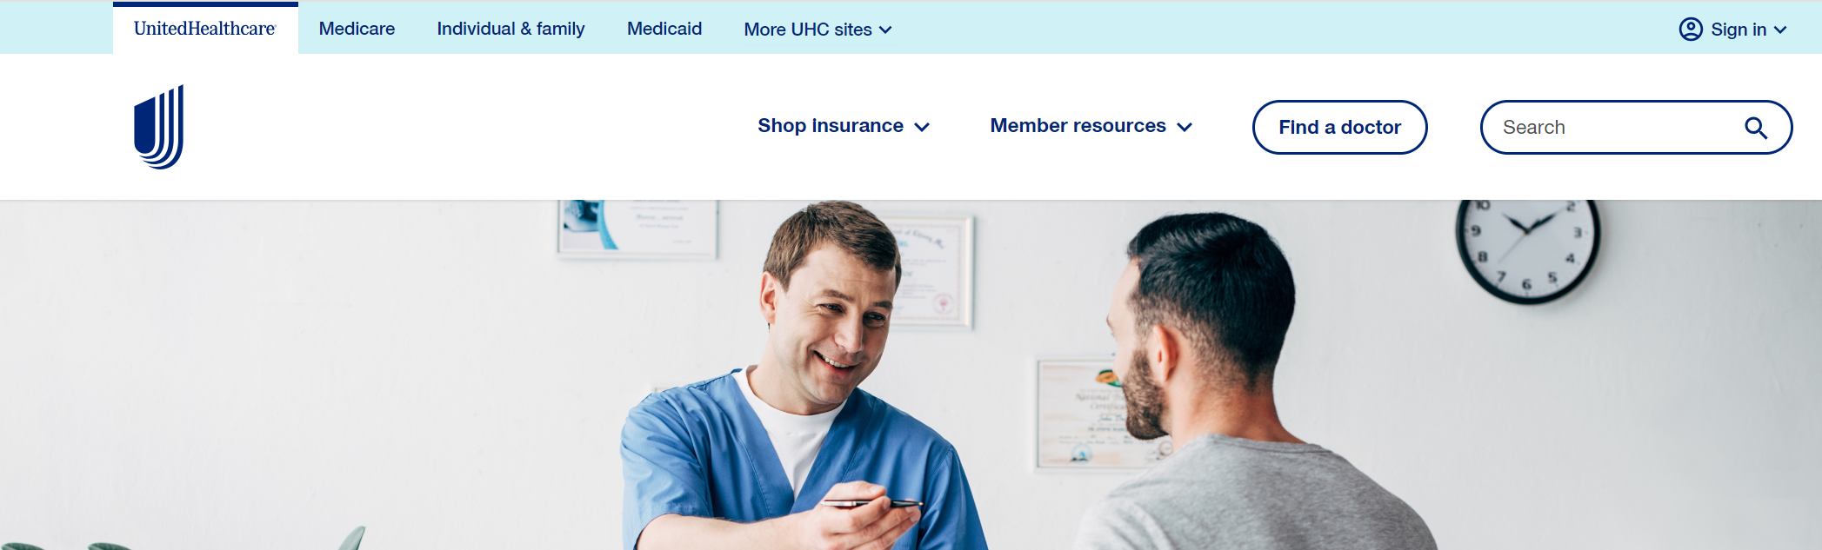
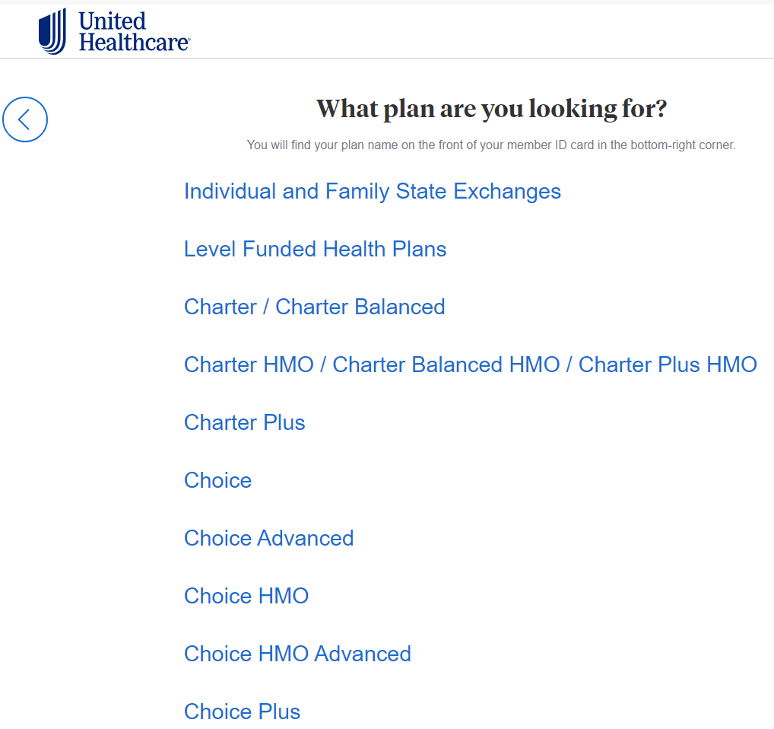
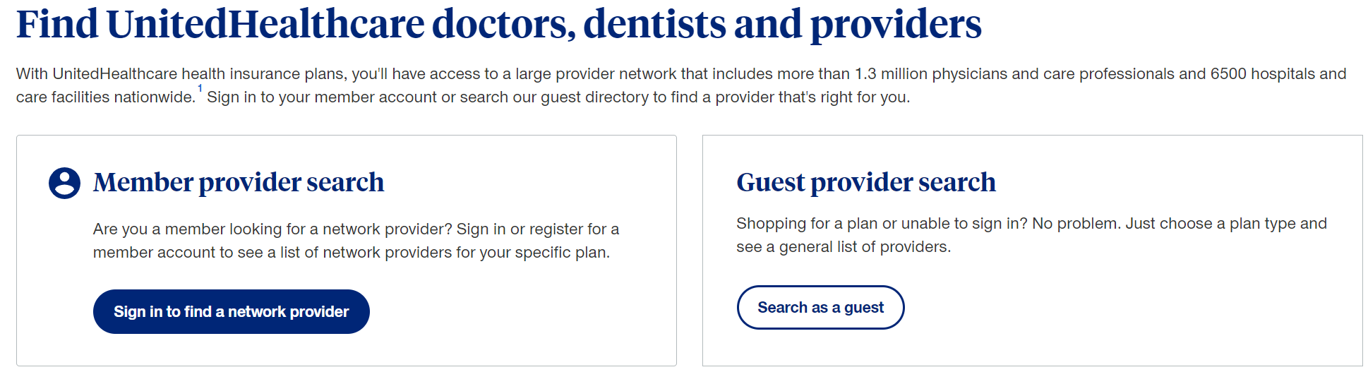
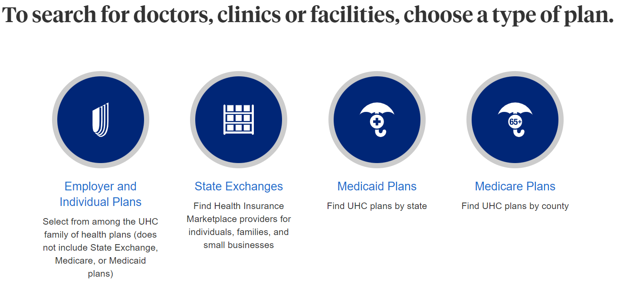
Steps to Finding a UHC In-Network Medical Provider
1. Visit www. UHC.com
2. Select “Find a Doctor” in the top right corner
3. If you are an existing UHC member select “Member Provider Search”. If you are not yet enrolled in the UHC plans, select “Guest Provider Search”
6. Next, select your medical plan. For the Base Medical Plan, select “Choice”. For the Buy Up Medical Plan, select “Choice Plus”
4. Select the type of provider you are looking for: Medical Directory.
5. Next, select “Employer or Individual Plans” when prompted to select your type of plan.
7. Once the plan is selected, you can then search for in-network providers by name, zip code, etc.

Slide 39

UHC Dental & Vision: How to use your Coverage
If enrolled in any of the UHC Dental or Vision plans, you will NOT receive an ID card – you will simply provide your Social Security Number or Date of Birth to the provider to verify your coverage.
To utilize the plans, first you will find a provider, ideally in-network with UHC. When completing your visit, you do not need to bring anything with you – simply provide your Social Security Number or Date of Birth.
Please keep in mind, it is important to utilize in-network providers to maximize your benefits. Using out-of-network providers may subject you to additional charges.

Slide 40
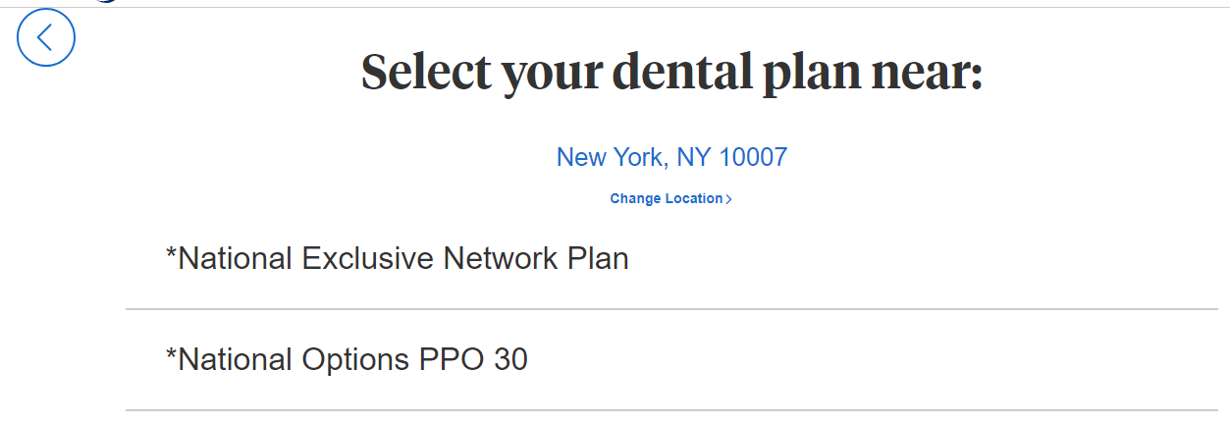
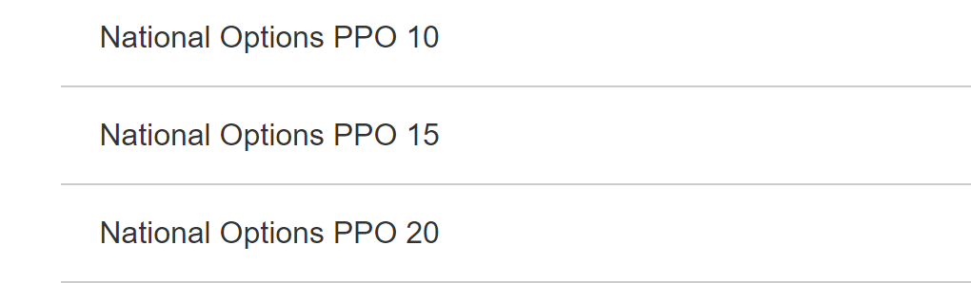
Steps to Finding a UHC In-Network Dental Provider
1. Visit www. UHC.com
2. Select “Find a Doctor” in the top right corner
3. If you are an existing UHC member select “Member Provider Search”. If you are not yet enrolled in the UHC plans, select “Guest Provider Search”
6. You will be prompted to enter your address, city, or zip code.
7. Next, select your dental plan. For the Base Dental Plan, select “National Options PPO 20”. For the Buy Up Dental Plan, select “National Options PPO 30”
4. Select the type of provider you are looking for: Dental Directory.
5. Next, select “Employer or Individual Plans” when prompted to select your type of plan.
8. Once the plan is selected, you can then search for in-network providers by name, zip code, etc.

Slide 41
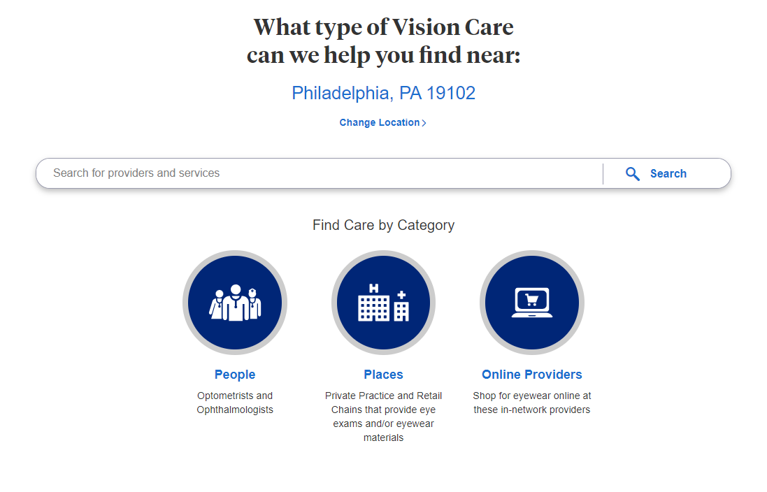
Steps to Finding a UHC In-Network Vision Provider
1. Visit www. UHC.com
2. Select “Find a Doctor” in the top right corner
3. If you are an existing UHC member select “Member Provider Search”. If you are not yet enrolled in the UHC plans, select “Guest Provider Search”
6. You will be prompted to enter your address, city, or zip code.
7. From there, you may search for providers by name, type, etc.
4. Select the type of provider you are looking for: Vision Directory.
5. Next, select “Employer or Individual Plans” when prompted to select your type of plan.

